Slide 1
CN: Physical Layer
Signals, Analog and Digital transmission: Analog signal, Digital Signal, Analog vs Digital, Data rate, Transmission impairments, Propagation delay, sampling, serial transmission, parallel transmission, ASK, FSK, PSK, QAM, modems

Slide 2
Analog and Digital Data
Data can be analog or digital.
Analog data are continuous and take continuous values.
Digital data have discrete states and take discrete values.
Analog data, such as the sounds made by a human voice, take on continuous values. When someone speaks, an analog wave is created in the air.
Digital data take on discrete values. For example, data are stored in computer memory in the form of 0’s and 1’s. They can be converted to a digital signal or modulated into an analog signal for transmission across a medium.

Slide 3
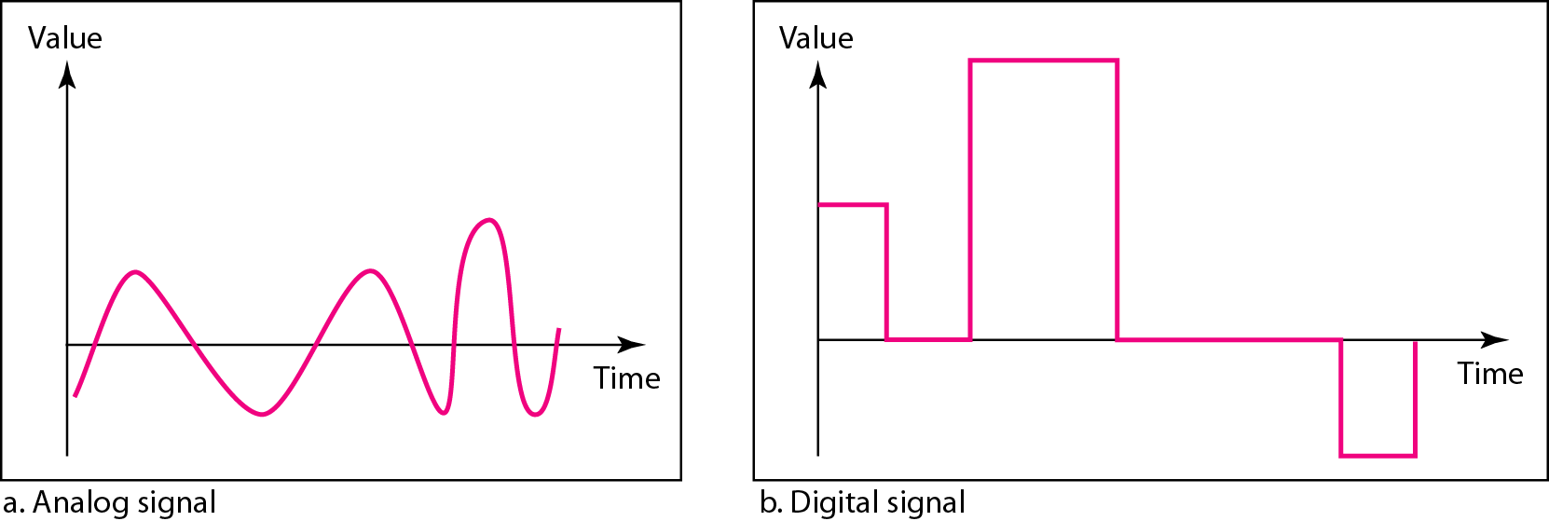
Analog and Digital Signals
Signals can be analog or digital.
Analog signals can have an infinite number of values in a range.
Digital signals can have only a limited number of values.

Slide 4
Periodic and Nonperiodic Signals
A periodic signal completes a pattern within a measurable time frame, called a period, and repeats that pattern over subsequent identical periods. The completion of one full pattern is called a cycle.
A nonperiodic signal changes without exhibiting a pattern or cycle that repeats over time.
Both analog and digital signals can be periodic or nonperiodic. In data communications, we commonly use periodic analog signals (because they need less bandwidth) and nonperiodic digital signals

Slide 5
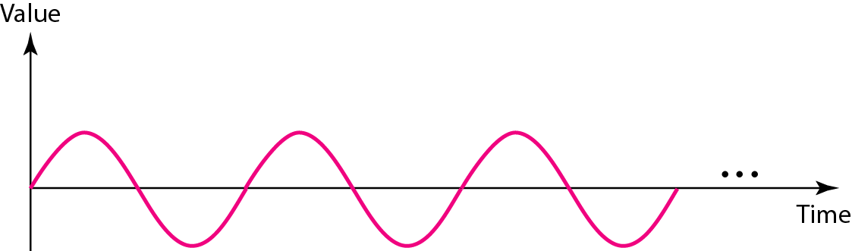
PERIODIC ANALOG SIGNALS
Periodic analog signals can be classified as simple or composite. A simple periodic analog signal, a sine wave, cannot be decomposed into simpler signals.
A composite periodic analog signal is composed of multiple sine waves.
A sine wave

Slide 6
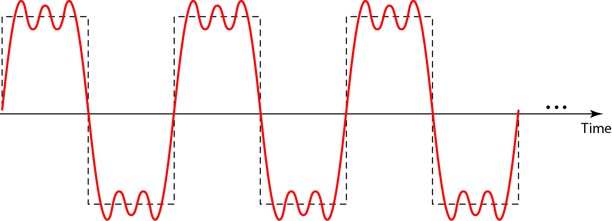
Figure 3.9 A composite periodic signal

Slide 7
Signals and Communication
A single-frequency sine wave is not useful in data communications
We need to send a composite signal, a signal made of many simple sine waves.
According to Fourier analysis, any composite signal is a combination of simple sine waves with different frequencies, amplitudes, and phases.

Slide 8
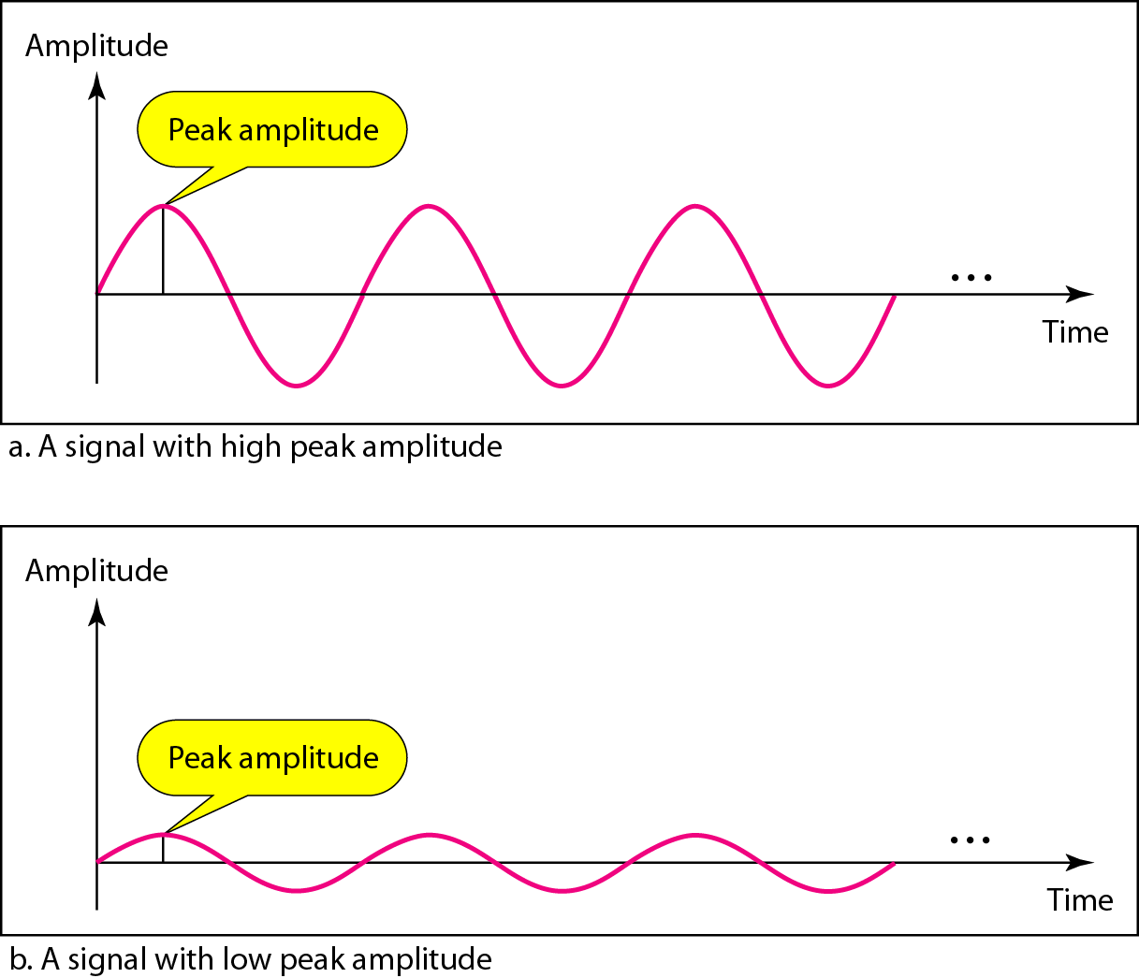
Figure 3.3 Two signals with the same phase and frequency, but different amplitudes

Slide 9
Frequency
Frequency is the rate of change with respect to time.
Change in a short span of time means high frequency.
Change over a long span of time means low frequency.
Phase describes the position of the waveform relative to time 0.

Slide 10


Note
Frequency and period are the inverse of each other.

Slide 11
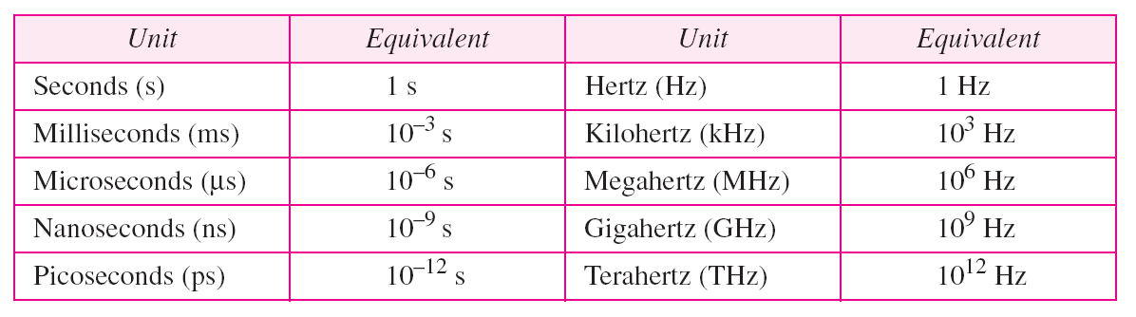
Table 3.1 Units of period and frequency

Slide 12
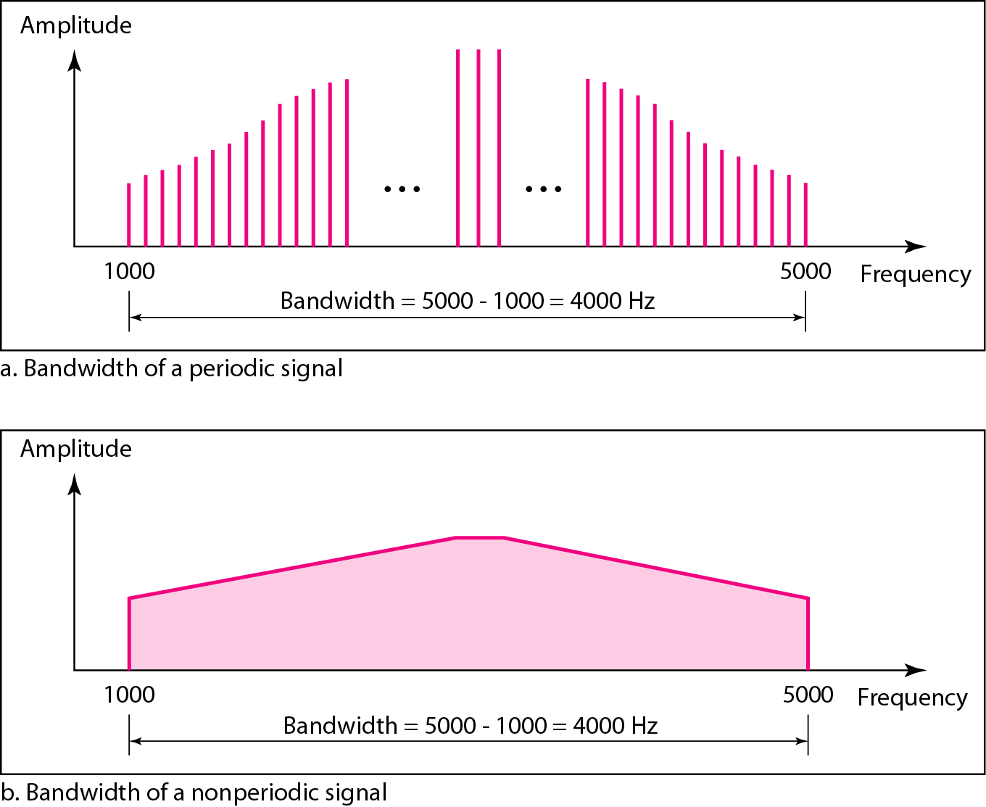
Bandwidth and Signal Frequency
The bandwidth of a composite signal is the difference between the highest and the lowest frequencies contained in that signal.

Slide 13
3-3 DIGITAL SIGNALS
In addition to being represented by an analog signal, information can also be represented by a digital signal.
For example, a 1 can be encoded as a positive voltage and a 0 as zero voltage. A digital signal can have more than two levels. In this case, we can send more than 1 bit for each level.

Slide 14
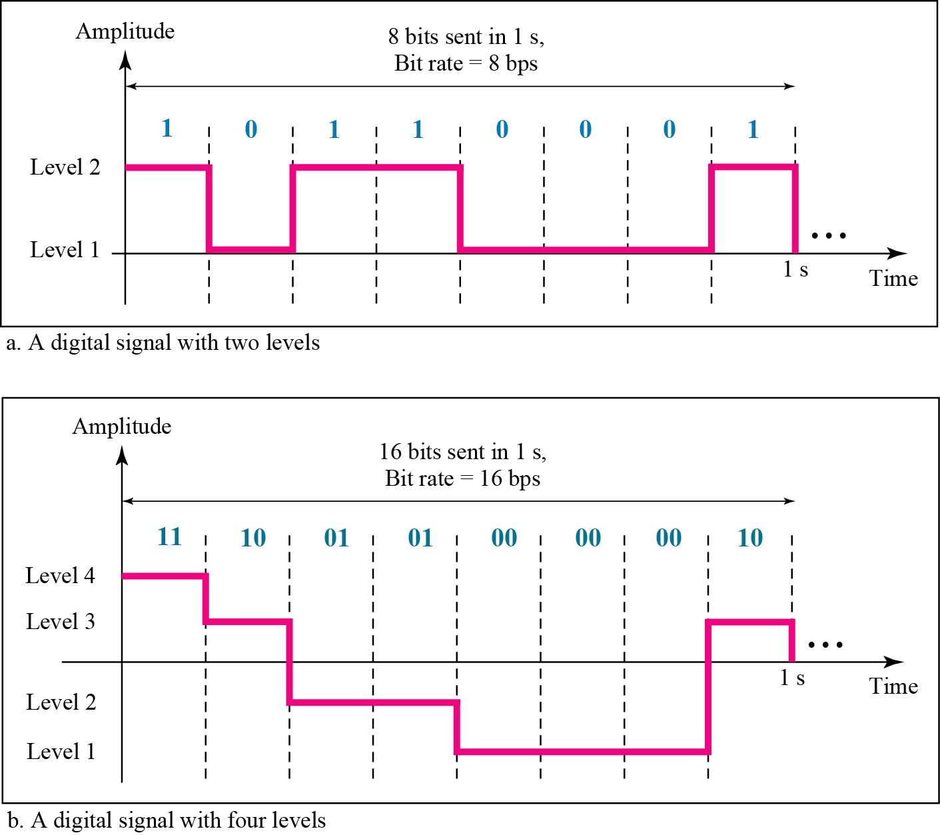
Figure 3.16 Two digital signals: one with two signal levels and the other with four signal levels

Slide 15
Example 3.16
A digital signal has eight levels. How many bits are needed per level? We calculate the number of bits from the formula
Each signal level is represented by 3 bits.

Slide 16
Transmission of Digital Signals
A digital signal, periodic or nonperiodic, is a composite analog signal with frequencies either zero or infinity. Consider a nonperiodic digital signal, similar to the ones we encounter in data communications.
The fundamental question is, How can we send a digital signal from point A to point B?
We can transmit a digital signal by using one of two different approaches: baseband transmission or broadband transmission

Slide 17
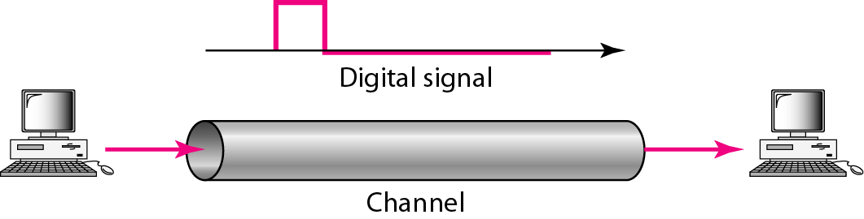
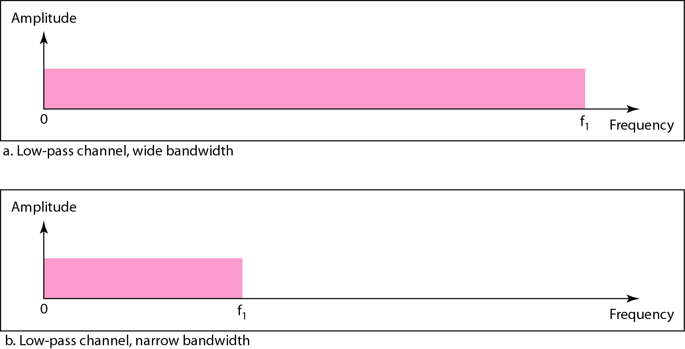
Baseband Transmission
Baseband transmission means sending a digital signal over a channel without changing the digital signal to an analog signal.
Requires Low pass channel to pass the signal.
Low Pass Channel: a channel with a bandwidth that starts from zero. This is the case if we have a dedicated medium with a bandwidth constituting only one channel.
For example, the entire bandwidth of a cable connecting two computers is one single channel.

Slide 18
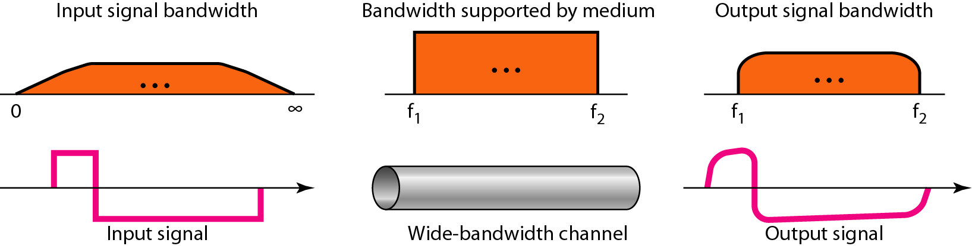
Baseband transmission using a dedicated medium
This means that if we have a medium, such as a coaxial cable or fiber optic, with a very wide bandwidth, two stations can communicate by using digital signals with very good accuracy.

Slide 19
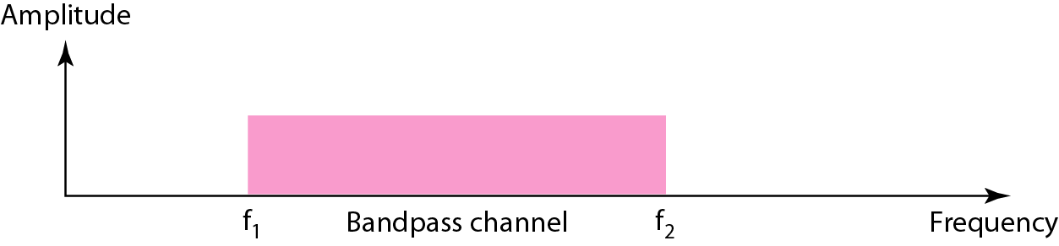
broadband transmission
Broadband transmission or modulation means changing the digital signal to an analog signal for transmission.
Modulation allows us to use a bandpass channel-a channel with a bandwidth that does not start from zero.
This type of channel is more available than a low-pass channel.

Slide 20
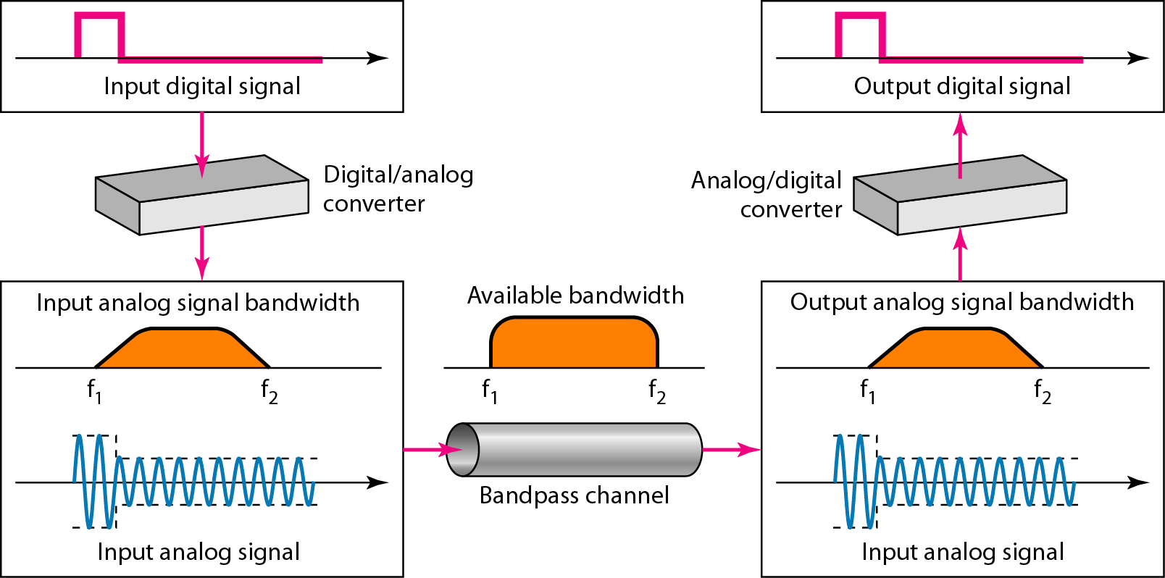
Figure 3.24 Modulation of a digital signal for transmission on a bandpass channel
Modem

Slide 21
3-4 TRANSMISSION IMPAIRMENT
Signals travel through transmission media, which are not perfect. The imperfection causes signal impairment. This means that the signal at the beginning of the medium is not the same as the signal at the end of the medium. What is sent is not what is received. Three causes of impairment are attenuation, distortion, and noise.
Topics discussed in this section:
Attenuation
Distortion
Noise

Slide 22
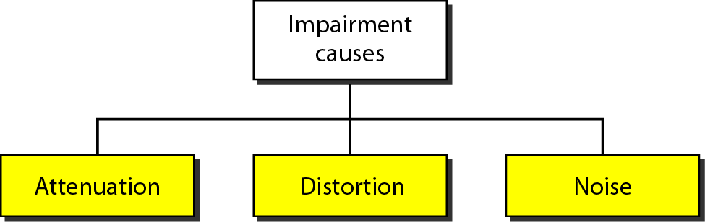
Figure 3.25 Causes of impairment

Slide 23
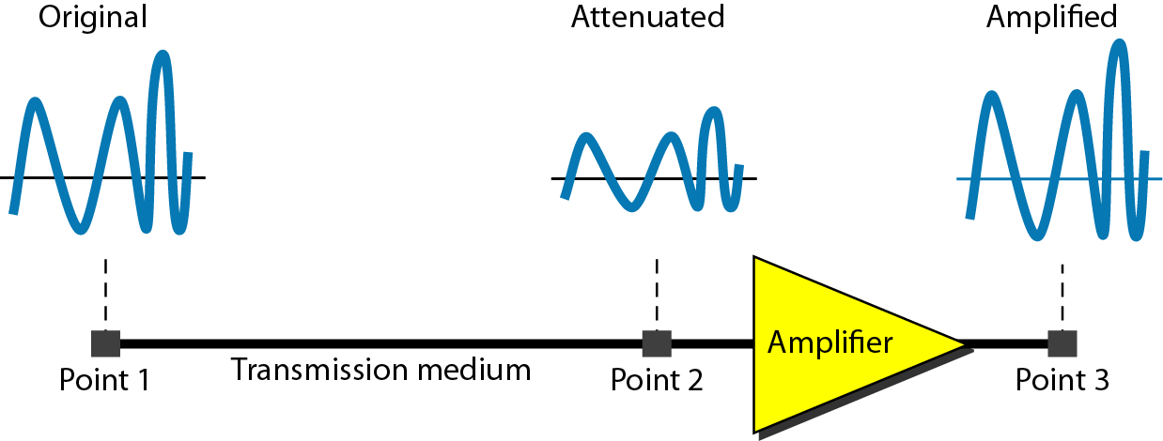
Attenuation
Means loss of energy -> weaker signal
When a signal travels through a medium it loses energy overcoming the resistance of the medium
Amplifiers are used to compensate for this loss of energy by amplifying the signal.

Slide 24
Measurement of Attenuation
To show the loss or gain of energy the unit “decibel” is used.
dB = 10log₁₀P₂/P₁
P₁ - input signal
P₂ - output signal

Slide 25

Example 3.26
Suppose a signal travels through a transmission medium and its power is reduced to one-half. This means that P2 is (1/2)P1. In this case, the attenuation (loss of power) can be calculated as
A loss of 3 dB (–3 dB) is equivalent to losing one-half the power.

Slide 26

Example 3.27
A signal travels through an amplifier, and its power is increased 10 times. This means that P₂ = 10P₁ . In this case, the amplification (gain of power) can be calculated as

Slide 27

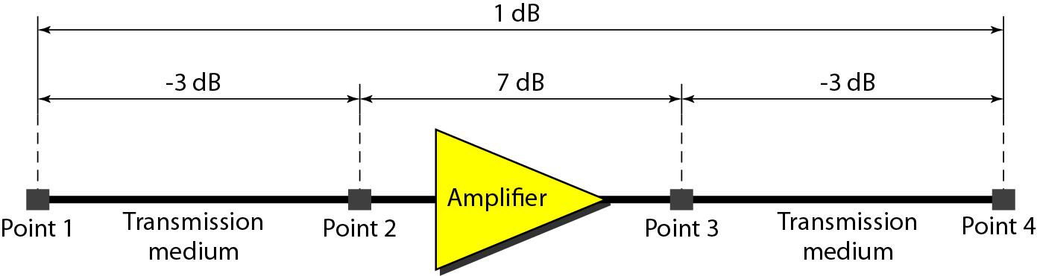
Example 3.28
One reason that engineers use the decibel to measure the changes in the strength of a signal is that decibel numbers can be added (or subtracted) when we are measuring several points (cascading) instead of just two. In Figure 3.27 a signal travels from point 1 to point 4. In this case, the decibel value can be calculated as

Slide 28
Distortion
Distortion means that the signal changes its form or shape.
Can occur in composite signal made of different frequencies.
Means that the signal changes its form or shape
Each frequency component has its own propagation speed traveling through a medium, therefore arrive with different delays at the receiver.
That means that the signals have different phases at the receiver than they did at the source.

Slide 29
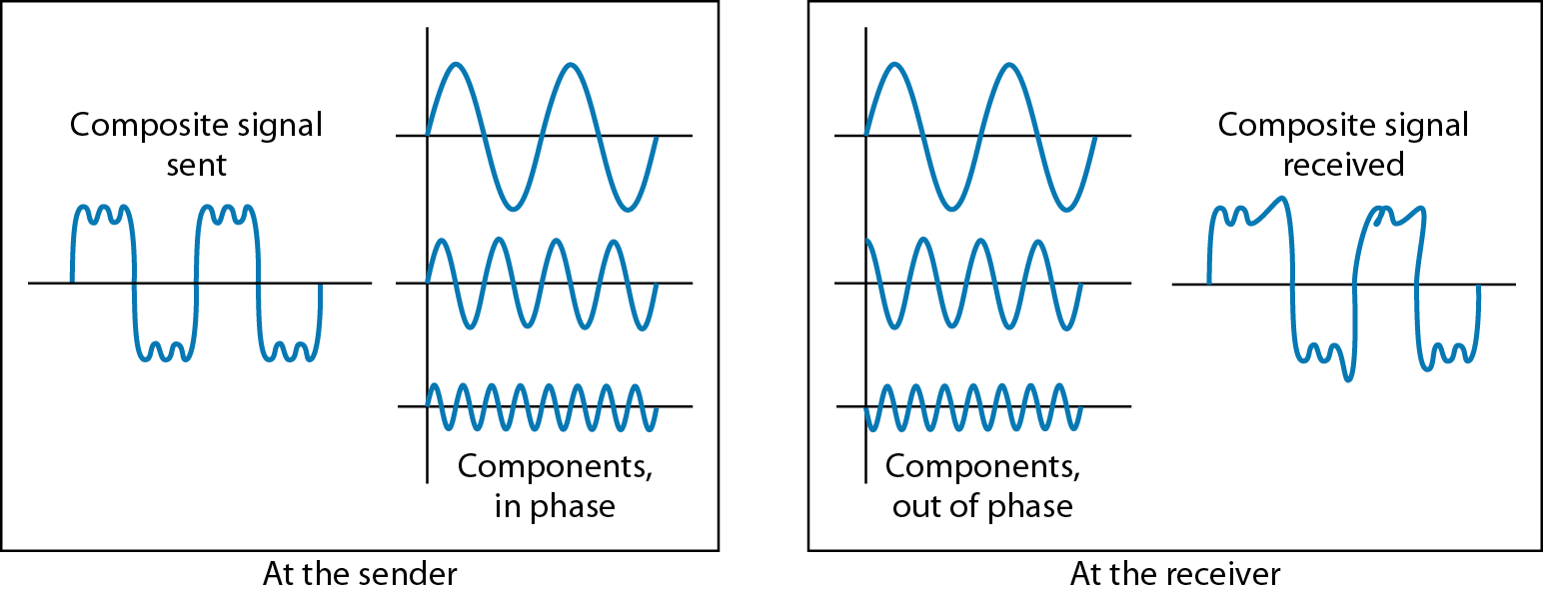
Figure 3.28 Distortion

Slide 30
Noise
Extra Information added to main signal.
There are different types of noise
Thermal - random noise of electrons in the wire creates an extra signal
Induced - from motors and appliances, devices act are transmitter antenna and medium as receiving antenna.
Crosstalk - same as above but between two wires.
Impulse - Spikes that result from power lines, lightning, etc.

Slide 31
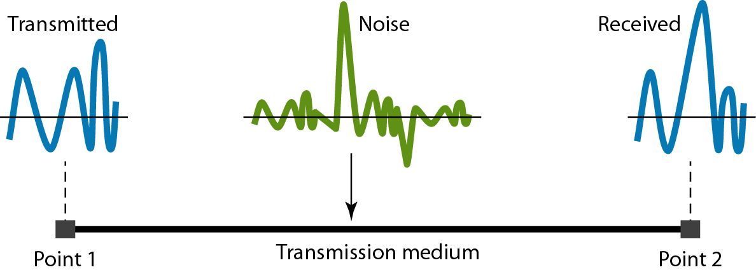
Figure 3.29 Noise

Slide 32
Signal to Noise Ratio (SNR)
To measure the quality of a system the SNR is often used. It indicates the strength of the signal wrt the noise power in the system.
It is the ratio between two powers.
It is usually given in dB and referred to as SNR_{dB.}
SNR=average signal power/average noise power
SNR is actually the ratio of what is wanted (signal) to what is not wanted (noise).
A high SNR means the signal is less corrupted by noise; a low SNR means the signal is more corrupted by noise.
Because SNR is the ratio of two powers, it is often described in decibel units,SNRdB, defined as:
SNRdB = l0logl0 SNR

Slide 33
Example 3.32
The values of SNR and SNRdB for a noiseless channel are
We can never achieve this ratio in real life; it is an ideal.

Slide 34
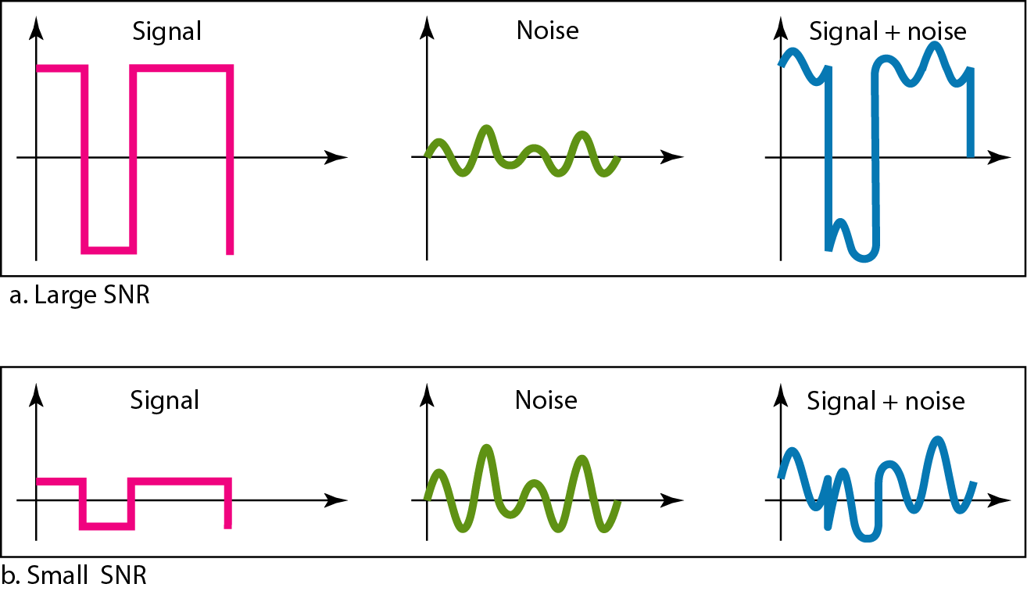
Figure 3.30 Two cases of SNR: a high SNR and a low SNR

Slide 35
3-5 DATA RATE LIMITS
A very important consideration in data communications is how fast we can send data, in bits per second, over a channel. Data rate depends on three factors:
1. The bandwidth available
2. The level of the signals we use
3. The quality of the channel (the level of noise)
Two theoretical formulas were developed to calculate the data rate: one by Nyquist for a noiseless channel, another by Shannon for a noisy channel.

Slide 36
Nyquist Theorem
For a noiseless channel, the Nyquist bit rate formula defines the theoretical maximum bit rate.
Nyquist theorem states that for a noiseless channel:
C = 2 B log₂L
C= capacity(Bit rate) in bps
B = bandwidth in Hz
In this formula, B is the bandwidth of the channel, L(2^{n}) is the number of signal levels used to represent data, and C is the bit rate in bits per second.

Slide 37
Example 3.34
Consider a noiseless channel with a bandwidth of 3000 Hz transmitting a signal with two signal levels. The maximum bit rate can be calculated as
Example 3.35
Consider the same noiseless channel transmitting a signal with four signal levels (for each level, we send 2 bits). The maximum bit rate can be calculated as

Slide 38
Example 3.36
We need to send 265 kbps over a noiseless channel with a bandwidth of 20 kHz. How many signal levels do we need?
Solution
We can use the Nyquist formula as shown:
Since this result is not a power of 2, we need to either increase the number of levels or reduce the bit rate. If we have 128 levels, the bit rate is 280 kbps. If we have 64 levels, the bit rate is 240 kbps.

Slide 39
Shannon’s Theorem
In reality, we cannot have a noiseless channel; the channel is always noisy.
In 1944, Claude Shannon introduced a formula, called the Shannon capacity, to determine the theoretical highest data rate for a noisy channel:
C = B log₂(1 + SNR)
Note that in the Shannon formula there is no indication of the signal level, which means that no matter how many levels we have, we cannot achieve a data rate higher than the capacity of the channel.
In other words, the formula defines a characteristic of the channel, not the method of transmission.

Slide 40
Example 3.37
Consider an extremely noisy channel in which the value of the signal-to-noise ratio is almost zero. In other words, the noise is so strong that the signal is faint. For this channel the capacity C is calculated as
This means that the capacity of this channel is zero regardless of the bandwidth. In other words, we cannot receive any data through this channel.

Slide 41
Example 3.38
We can calculate the theoretical highest bit rate of a regular telephone line. A telephone line normally has a bandwidth of 3000. The signal-to-noise ratio is usually 3162. For this channel the capacity is calculated as
This means that the highest bit rate for a telephone line is 34.860 kbps. If we want to send data faster than this, we can either increase the bandwidth of the line or improve the signal-to-noise ratio.

Slide 42
4-3 TRANSMISSION MODES
Do we send 1 bit at a time; or do we group bits into larger groups and, if so, how? The transmission of binary data across a link can be accomplished in either parallel or serial mode.
The transmission of binary data across a link can be accomplished in either parallel or serial mode.
In parallel mode, multiple bits are sent with each clock tick.
In serial mode, 1 bit is sent with each clock tick.
While there is only one way to send parallel data, there are three subclasses of serial transmission: asynchronous, synchronous, and isochronous.
Parallel Transmission
Serial Transmission

Slide 43
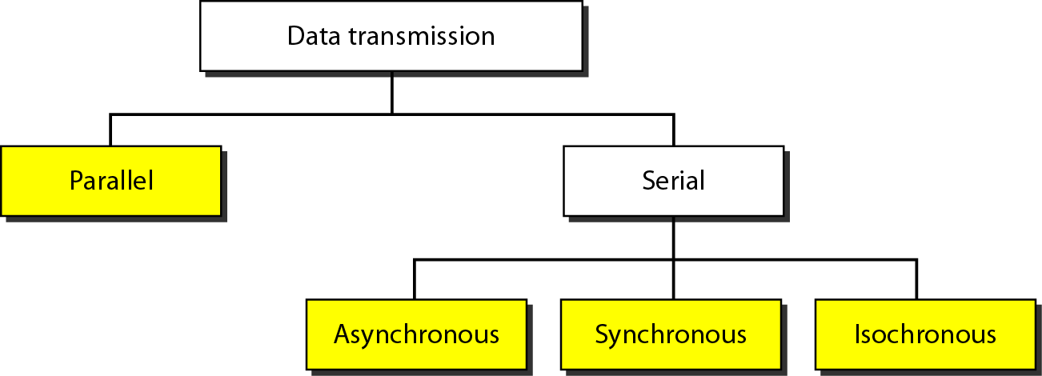
Figure 4.31 Data transmission and modes

Slide 44
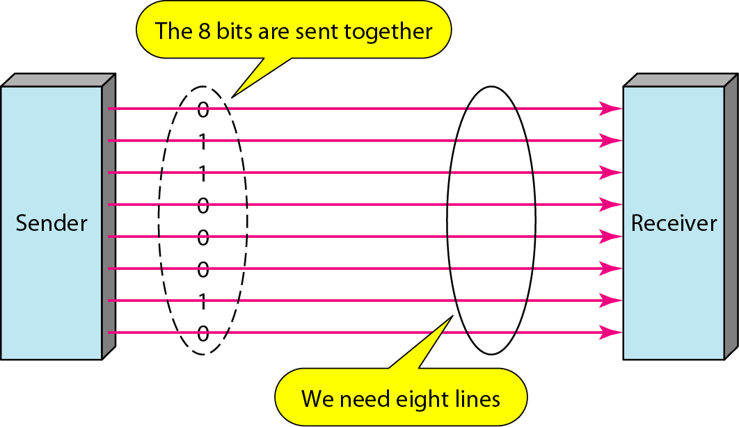
Parallel transmission
The mechanism for parallel transmission is a conceptually simple one: Use n wires to send n bits at one time.
That way each bit has its own wire, and all n bits of one group can be transmitted with each clock tick from one device to another.
The advantage of parallel transmission is speed. All else being equal, parallel transmission can increase the transfer speed by a factor of n over serial transmission.
But there is a significant disadvantage: cost. Parallel transmission requires n communication lines (wires in the example) just to transmit the data stream.
Because this is expensive, parallel transmission is usually limited to short distances.

Slide 45
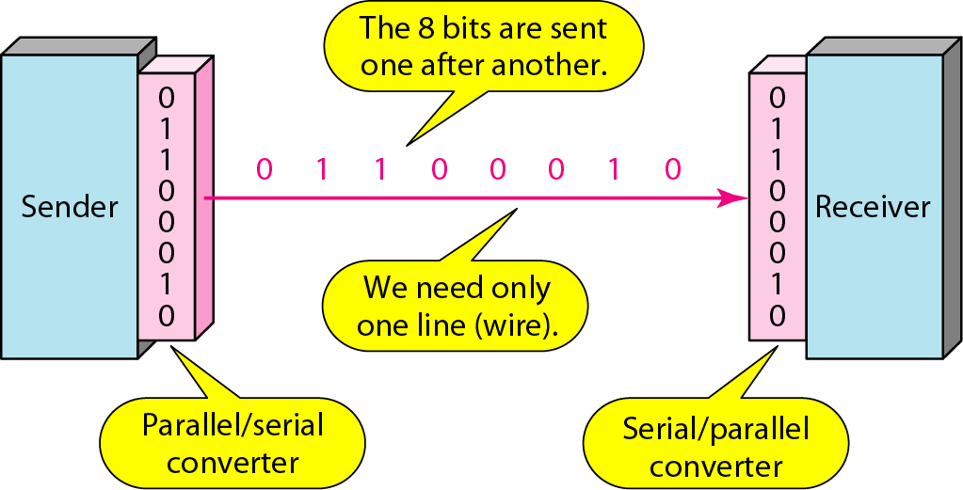
Serial transmission
Advantage: only one communication channel required.
Serial transmission reduces the cost of transmission over parallel by roughly a factor of n.
Conversion devices are required at the interface between the sender and the line (parallel-to-serial) and between the line and the receiver (serial-to-parallel).
Serial transmission occurs in one of three ways: asynchronous, synchronous, and isochronous.

Slide 46
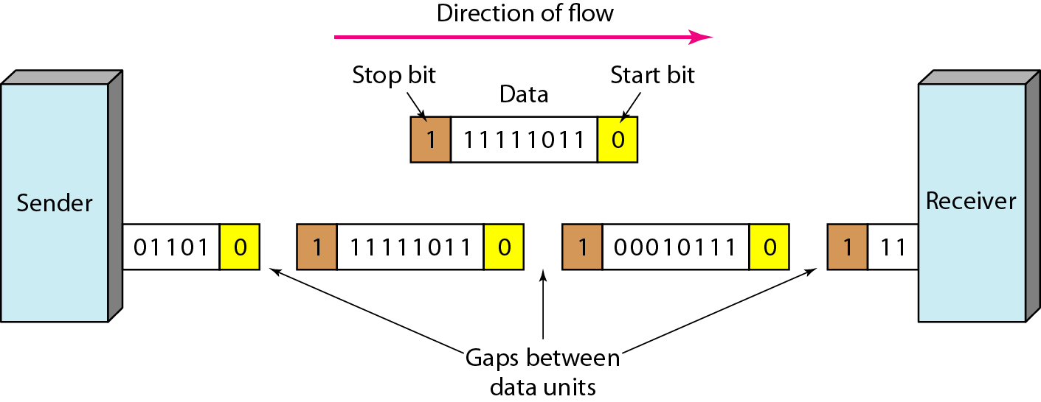
Asynchronous transmission
Due Idle channel
Information is received and translated by agreed upon patterns. As long as those patterns are followed, the receiving device can retrieve the information without regard to the rhythm in which it is sent.
In asynchronous transmission, we send 1 start bit (0) at the beginning and 1 or more stop bits (Is) at the end of each byte. There may be a gap between each byte.
The start and stop bits and the gap alert the receiver to the beginning and end of each byte and allow it to synchronize with the data stream.

Slide 47
Asynchronous here means “asynchronous at the byte level,”
but the bits are still synchronized; their durations are the same.
Within each byte, the receiver must still be synchronized with the incoming bit stream. That is, some synchronization is required, but only for the duration of a single byte.
When the receiver detects a start bit, it sets a timer and begins counting bits as they come in.
The addition of stop and start bits and the insertion of gaps into the bit stream make asynchronous transmission slower than forms of transmission that can operate without the addition of control information.
It is cheap and effective.
Example: Keyboard

Slide 48
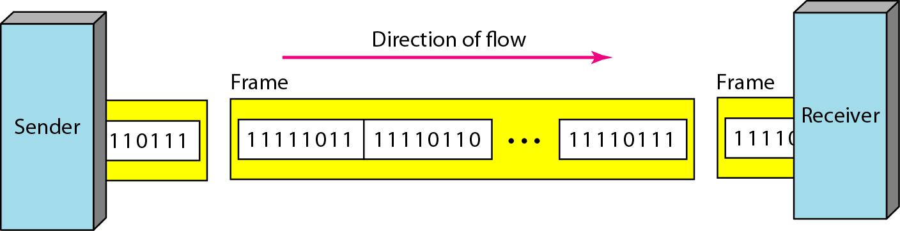
synchronous transmission
In synchronous transmission, the bit stream is combined into longer "frames," which may contain multiple bytes.
It is left to the receiver to separate the bit stream into bytes for decoding purposes.
Timing becomes very important, therefore, because the accuracy of the received information is completely dependent on the ability of the receiving device to keep an accurate count of the bits as they come in.

Slide 49
synchronous transmission
The advantage of synchronous transmission is speed. With no extra bits.
more useful for high-speed applications.
Byte synchronization is accomplished in the data link layer.
Although there is no gap between characters in synchronous serial transmission, there may be uneven gaps between frames.

Slide 50
Isochronous
In isochronous transmission we cannot have uneven gaps between frames.
Transmission of bits is fixed with equal gaps.
In real-time audio and video, in which uneven delays between frames are not acceptable, synchronous transmission fails.
For example, TV images are broadcast at the rate of 30 images per second; they must be viewed at the same rate.
If each image is sent by using one or more frames, there should be no delays between frames.
For this type of application, synchronization between characters is not enough; the entire stream of bits must be synchronized.
The isochronous transmission guarantees that the data arrive at a fixed rate.

Slide 51
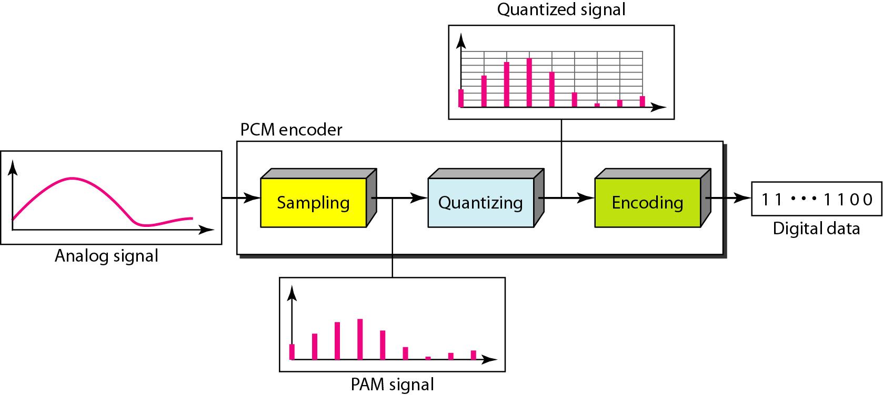
ANALOG-TO-DIGITAL CONVERSION (ex: Camera)
Pulse code modulation
Basic PCM Encoder Steps include:
Sampling
Quantization
Binary encoding

Slide 52
Sampling
Analog signal is sampled every T_{S} secs.
T_{s} is referred to as the sampling interval.
f_{s} = 1/T_{s} is called the sampling rate or sampling frequency.
There are 3 sampling methods:
Ideal - an impulse at each sampling instant
Natural - a pulse of short width with varying amplitude
Flattop - sample and hold, like natural but with single amplitude value
The process is referred to as pulse amplitude modulation PAM and the outcome is a signal with analog (non integer) values

Slide 53
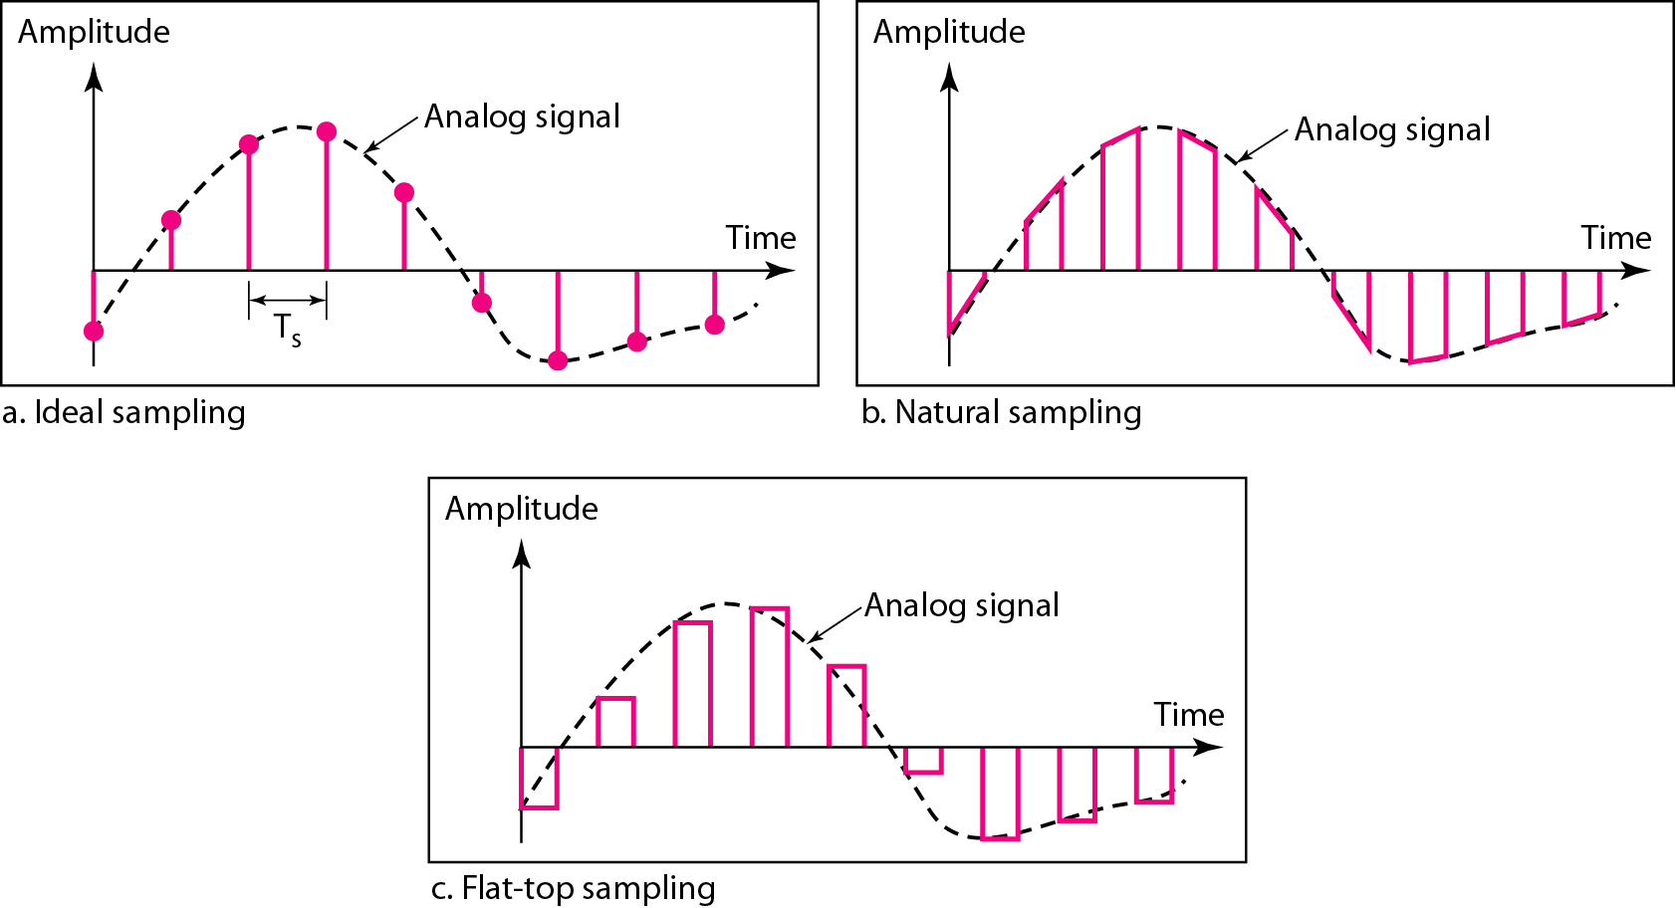
Figure 4.22 Three different sampling methods for PCM

Slide 54
Note
According to the Nyquist theorem, the sampling rate must be
at least 2 times the highest frequency contained in the signal.

Slide 55
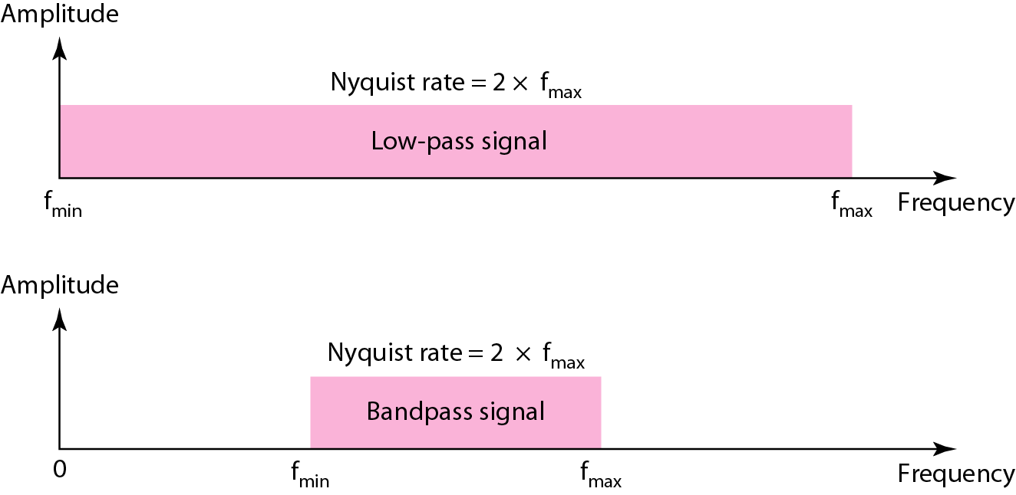
Figure 4.23 Nyquist sampling rate for low-pass and bandpass signals

Slide 56
Example 4.6
For an intuitive example of the Nyquist theorem, let us sample a simple sine wave at three sampling rates: f_{s} = 4f (2 times the Nyquist rate), f_{s} = 2f (Nyquist rate), and f_{s} = f (one-half the Nyquist rate). Figure 4.24 shows the sampling and the subsequent recovery of the signal.
It can be seen that sampling at the Nyquist rate can create a good approximation of the original sine wave (part a). Oversampling in part b can also create the same approximation, but it is redundant and unnecessary. Sampling below the Nyquist rate (part c) does not produce a signal that looks like the original sine wave.

Slide 57
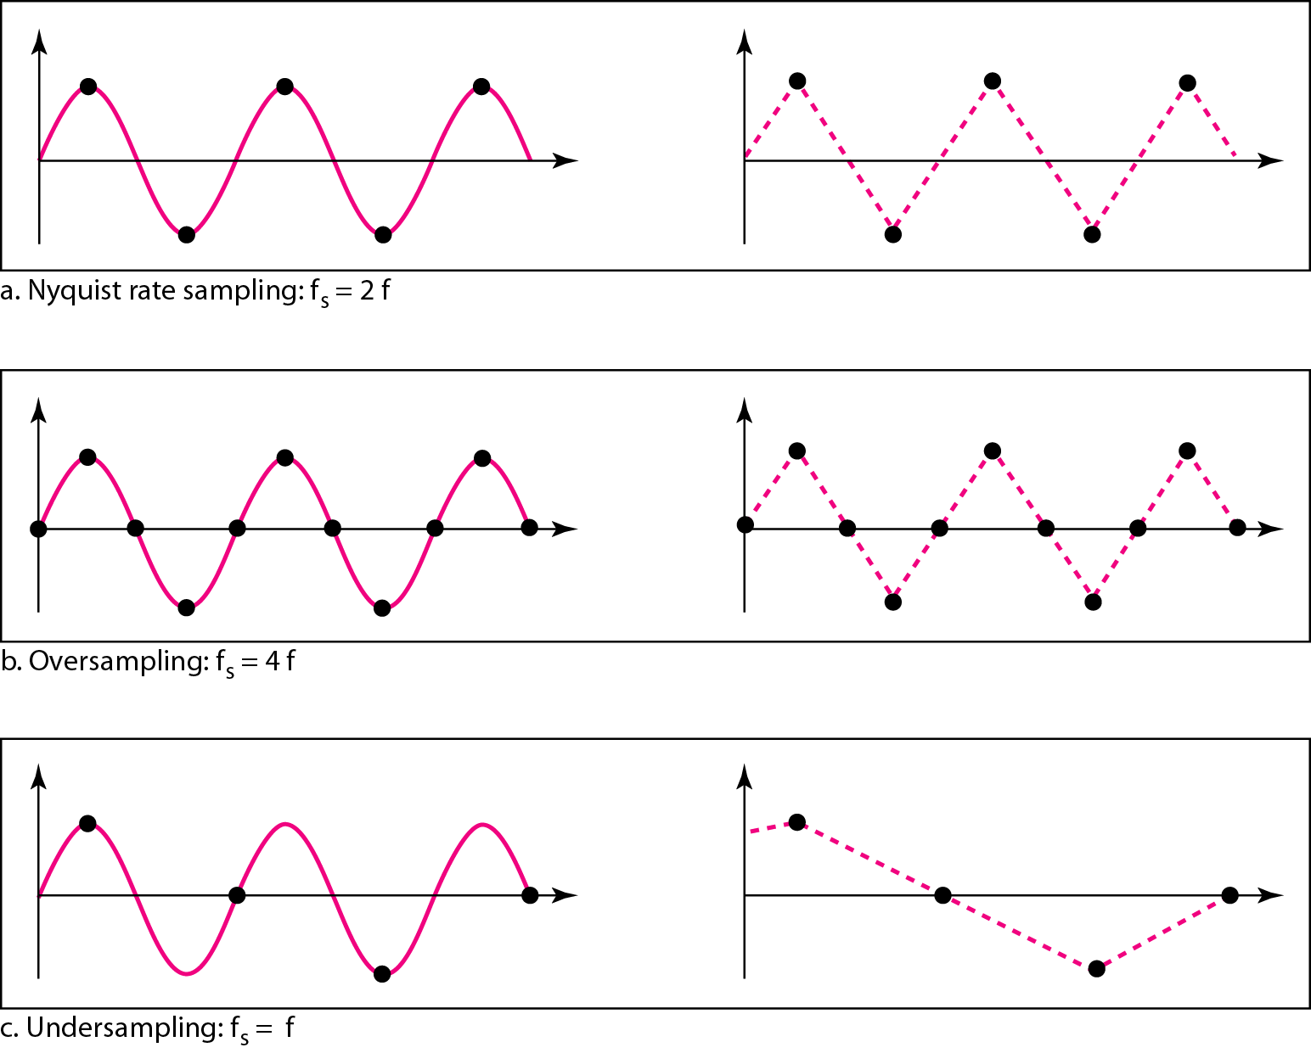
Figure 4.24 Recovery of a sampled sine wave for different sampling rates

Slide 58
Quantization
Sampling results in a series of pulses of varying amplitude values ranging between two limits: a min and a max.
The amplitude values are infinite between the two limits.
We need to map the infinite amplitude values onto a finite set of known values.
This is achieved by dividing the distance between min and max into L zones, each of height Δ.
Δ = (max - min)/L

Slide 59
Quantization Levels
The midpoint of each zone is assigned a value from 0 to L-1 (resulting in L values)
Each sample falling in a zone is then approximated to the value of the midpoint.
Assume we have a voltage signal with amplitutes V_{min}=-20V and V_{max}=+20V.
We want to use L=8 quantization levels.
Zone width Δ = (20 - -20)/8 = 5
The 8 zones are: -20 to -15, -15 to -10, -10 to -5, -5 to 0, 0 to +5, +5 to +10, +10 to +15, +15 to +20
The midpoints are: -17.5, -12.5, -7.5, -2.5, 2.5, 7.5, 12.5, 17.5

Slide 60
Assigning Codes to Zones
Each zone is then assigned a binary code.
The number of bits required to encode the zones, or the number of bits per sample as it is commonly referred to, is obtained as follows:
n_{b} = log₂ L
Given our example, n_{b} = 3
The 8 zone (or level) codes are therefore: 000, 001, 010, 011, 100, 101, 110, and 111
Assigning codes to zones:
000 will refer to zone -20 to -15
001 to zone -15 to -10, etc.

Slide 61
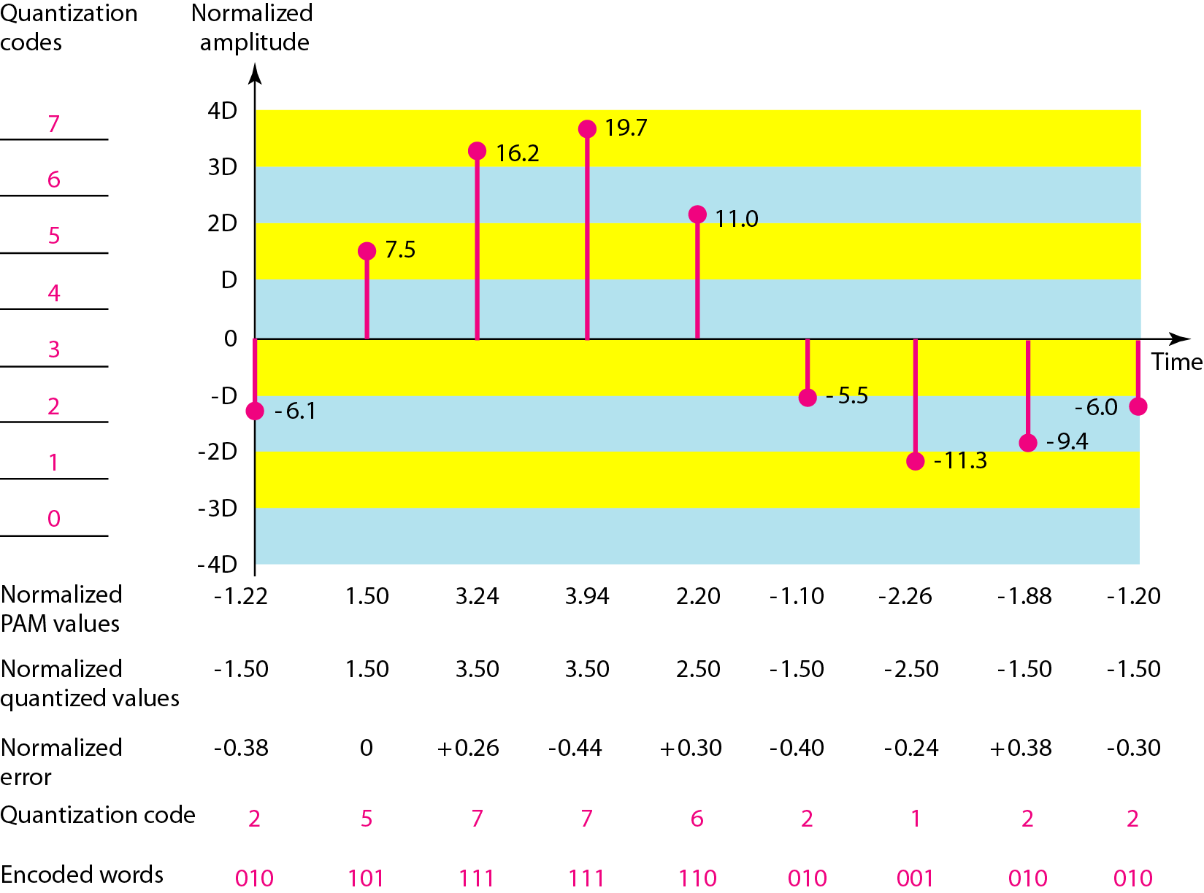
Figure 4.26 Quantization and encoding of a sampled signal
17.5,
12.5,
7.5,
2.5,
-2.5,
-7.5,
-12.5,
-17.5
Normalized PAM = actual amplitude/hight of zone (5 here)
Nearest Central zone
Error = Normalized quantized value-normalized PAM Value

Slide 62
PCM Decoder
To recover an analog signal from a digitized signal we follow the following steps:
We use a hold circuit that holds the amplitude value of a pulse till the next pulse arrives.
We pass this signal through a low pass filter with a cutoff frequency that is equal to the highest frequency in the pre-sampled signal.
The higher the value of L, the less distorted a signal is recovered.

Slide 63
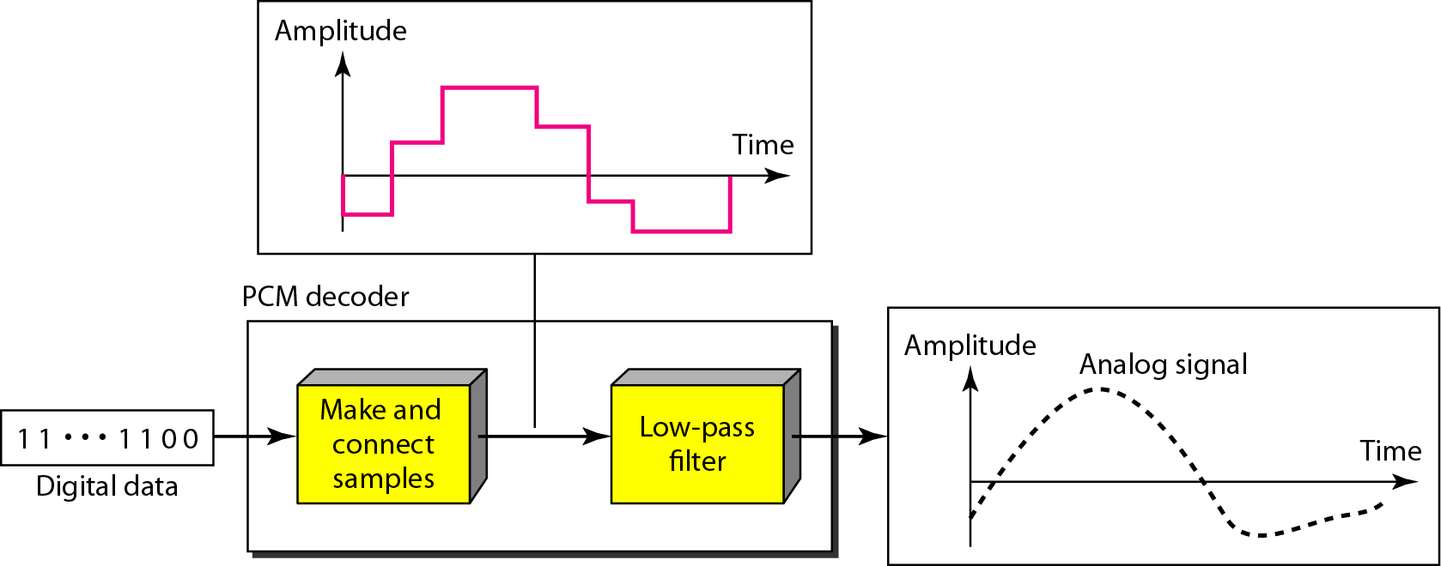
Figure 4.27 Components of a PCM decoder

Slide 64
5-1 DIGITAL-TO-ANALOG CONVERSION
Digital-to-analog conversion is the process of changing one of the characteristics of an analog signal based on the information in digital data.
Topics discussed in this section:
Aspects of Digital-to-Analog Conversion
Amplitude Shift Keying
Frequency Shift Keying
Phase Shift Keying
Quadrature Amplitude Modulation

Slide 65
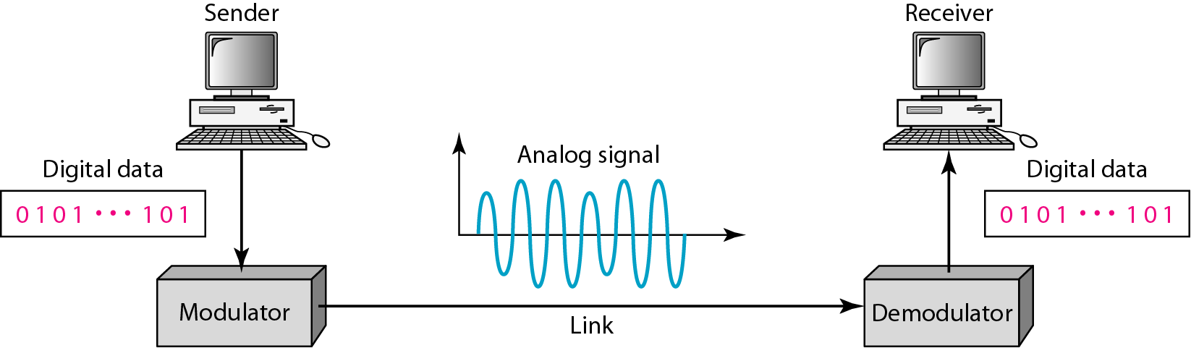
Digital to Analog Conversion
Digital data needs to be carried on an analog signal.
A carrier signal (frequency f_{c}) performs the function of transporting the digital data in an analog waveform.
The analog carrier signal is manipulated to uniquely identify the digital data being carried.
Figure 5.1 Digital-to-analog conversion

Slide 66
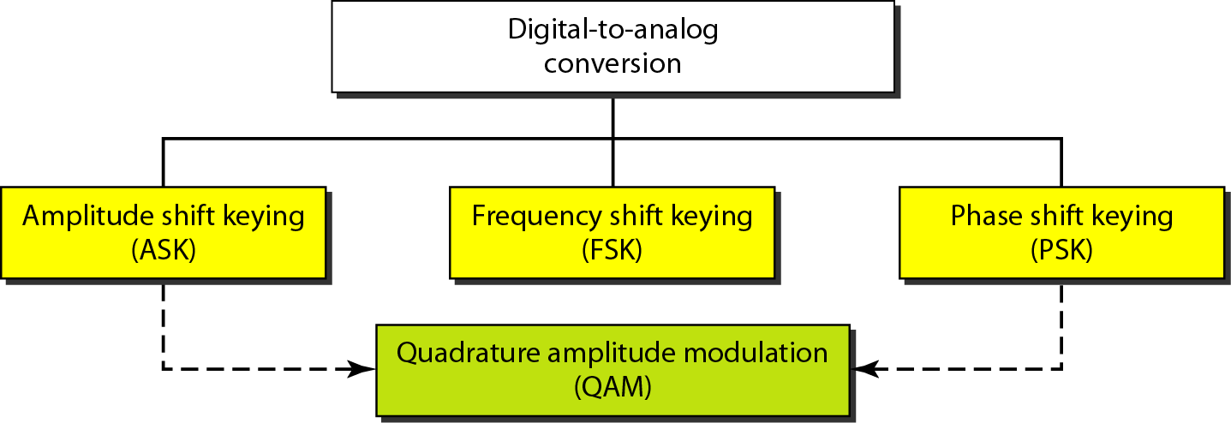
Figure 5.2 Types of digital-to-analog conversion
A sine wave is defined by three characteristics: amplitude, frequency, and phase.
When we vary anyone of these characteristics, we create a different version of that wave.
Any of the three characteristics can be altered in this way, giving us at least three mechanisms for modulating digital data into an analog signal: (ASK), (FSK), and (PSK).
In addition, there is a fourth (and better) mechanism that combines changing both the amplitude and phase, called quadrature amplitude modulation (QAM).
QAM is the most efficient of these options and is the mechanism commonly used today

Slide 67
Amplitude Shift Keying (ASK)
ASK is implemented by changing the amplitude of a carrier signal to reflect amplitude levels in the digital signal.
For example: a digital “1” could not affect the signal, whereas a digital “0” would, by making it zero.
The line encoding will determine the values of the analog waveform to reflect the digital data being carried.

Slide 68
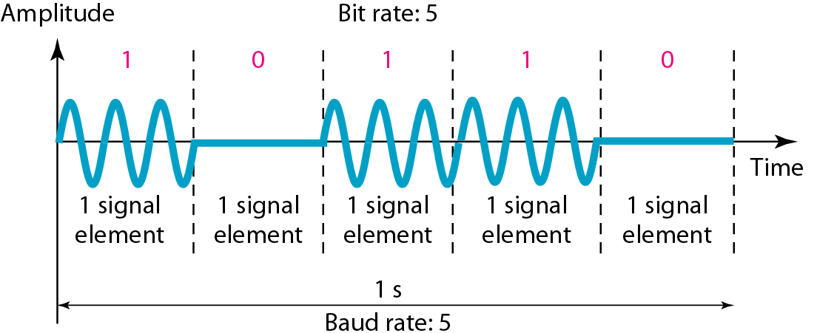
Figure 5.3 Binary amplitude shift keying

Slide 69
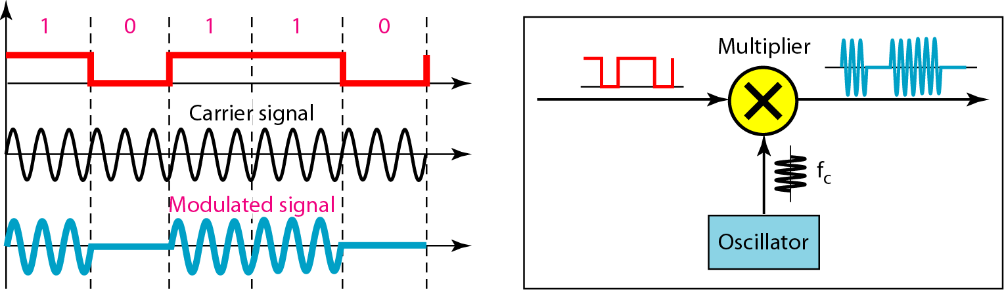
Figure 5.4 Implementation of binary ASK

Slide 70
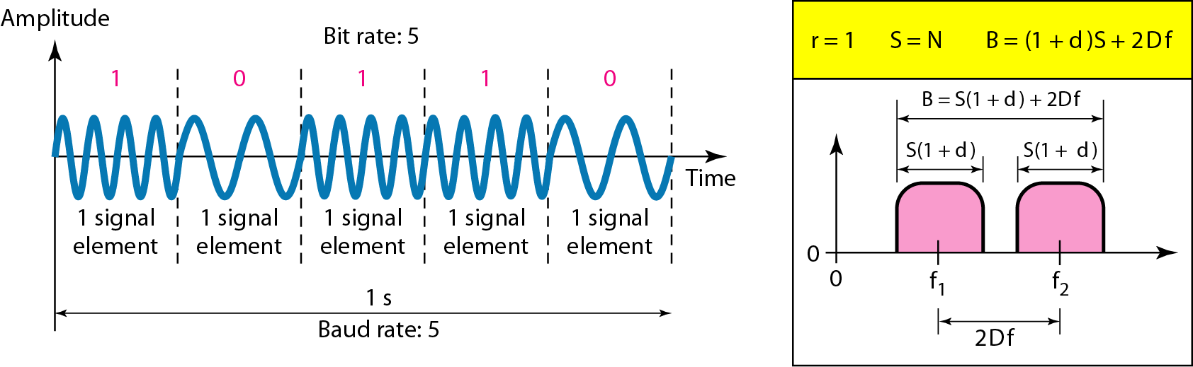
Frequency Shift Keying
In frequency shift keying, the frequency of the carrier signal is varied to represent data.
The digital data stream changes the frequency of the carrier signal, f_{c}.
For example, a “1” could be represented by f₁=f_{c} +Δf, and a “0” could be represented by f₂=f_{c}-Δf.
Figure 5.6 Binary frequency shift keying

Slide 71
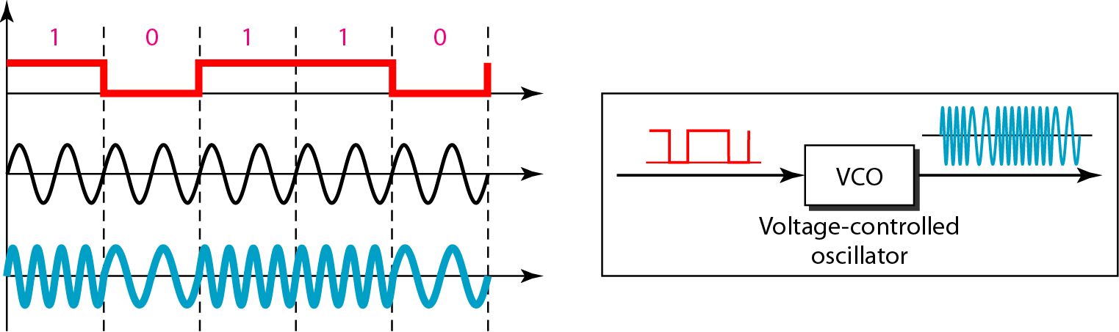
Figure 5.7 Implementation of BFSK

Slide 72
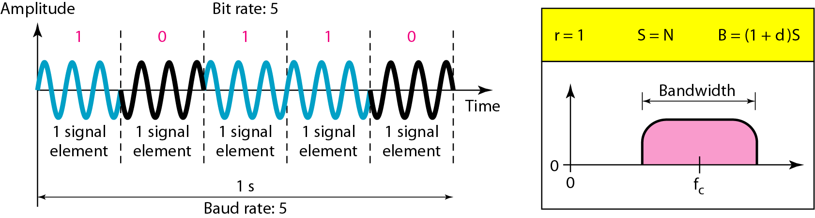
Phase Shift Keyeing
We vary the phase shift of the carrier signal to represent digital data.
PSK is much more robust than ASK as it is not that vulnerable to noise, which changes amplitude of the signal.

Slide 73
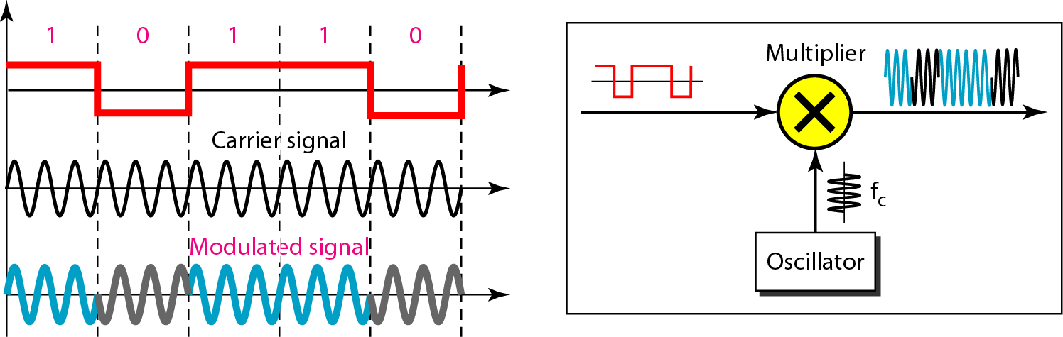
Figure 5.10 Implementation of BPSK
The implementation of BPSK is as simple as that for ASK. The reason is that the signal element with phase 180° can be seen as the complement of the signal element with phase 0°.

Slide 74
Quadrature PSK
The simplicity of BPSK enticed designers to use 2 bits at a time in each signal element, thereby decreasing the baud rate and eventually the required bandwidth.
To increase the bit rate, we can code 2 or more bits onto one signal element.
In QPSK, we parallelize the bit stream so that every two incoming bits are split up and PSK a carrier frequency. One carrier frequency is phase shifted 90º from the other - in quadrature.
The two PSKed signals are then added to produce one of 4 signal elements. L = 4 here.

Slide 75
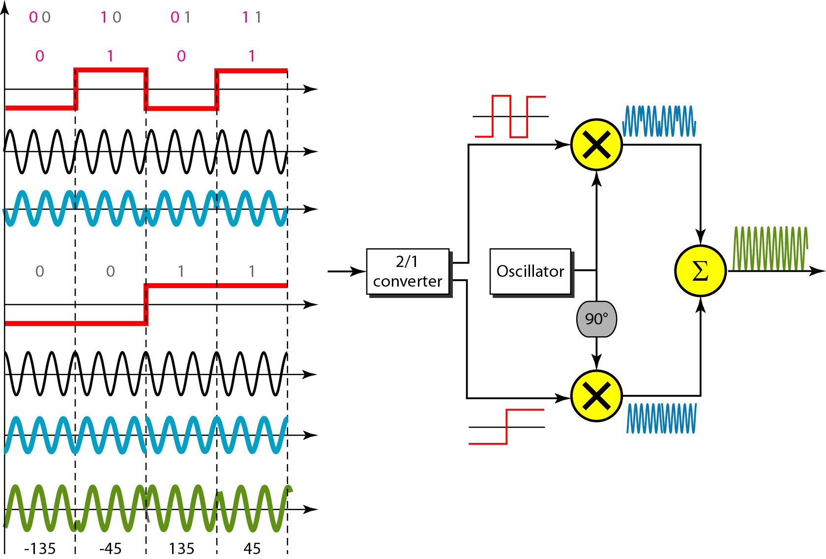
Figure 5.11 QPSK and its implementation
Modulator 1
Modulator 2
Composite Signal

Slide 76
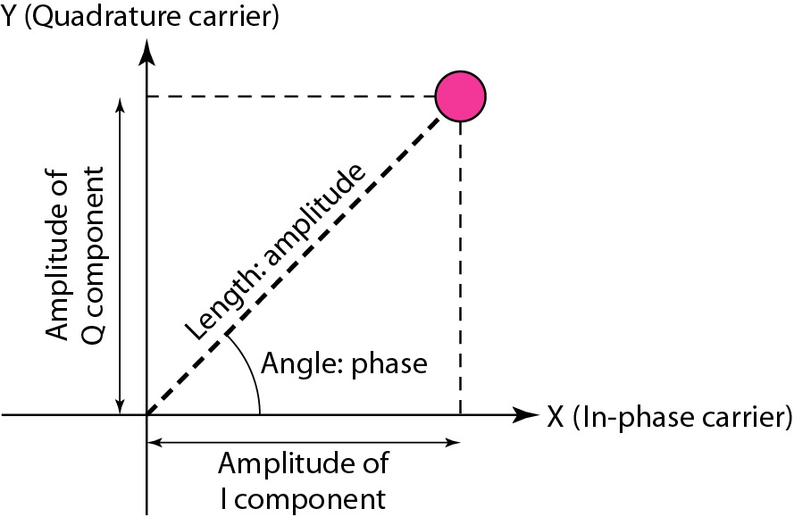
Constellation Diagrams
A constellation diagram helps us to define the amplitude and phase of a signal when we are using two carriers, one in quadrature of the other.
The X-axis represents the in-phase carrier, and the Y-axis represents quadrature carrier.
Figure 5.12 Concept of a constellation diagram

Slide 77
Example 5.8
Show the constellation diagrams for an ASK (OOK), BPSK, and QPSK signals.
Solution
Figure 5.13 shows the three constellation diagrams.

Slide 78
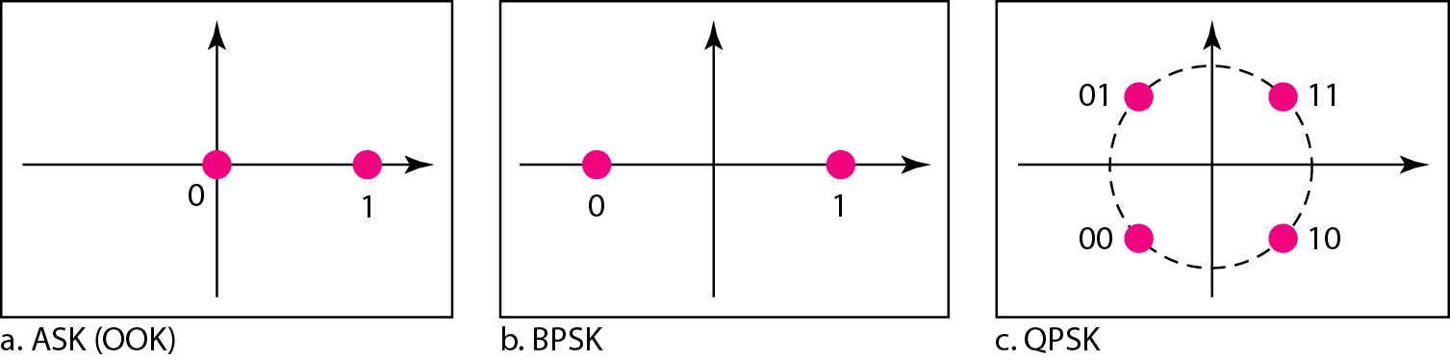
Figure 5.13 Three constellation diagrams

Slide 79
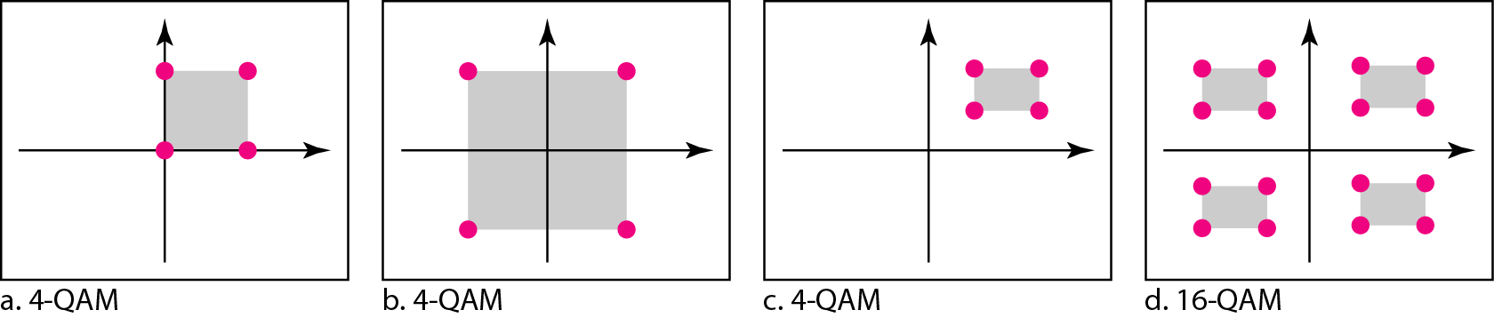
Figure 5.14 Constellation diagrams for some QAMs

Slide 80
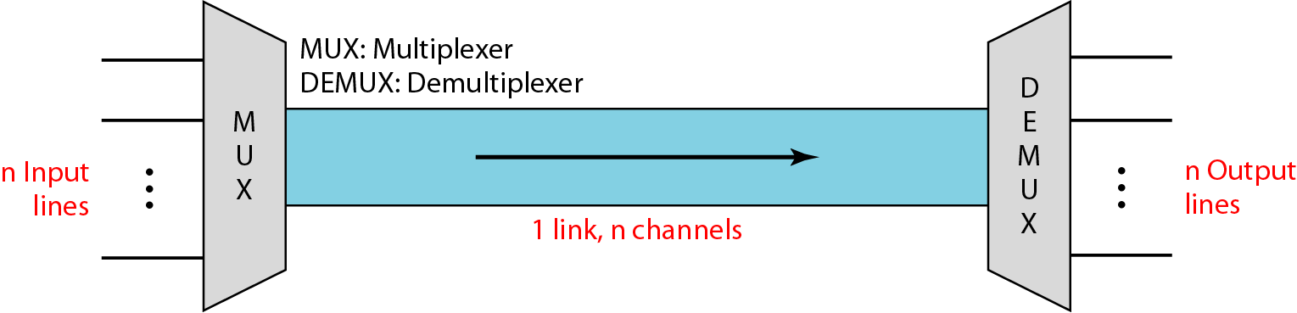
Bandwidth Utilization: Multiplexing
Bandwidth utilization is the wise use of available bandwidth to achieve specific goals.
Efficiency can be achieved by multiplexing; i.e., sharing of the bandwidth between multiple users.
Whenever the bandwidth of a medium linking two devices is greater than the bandwidth needs of the devices, the link can be shared.

Slide 81
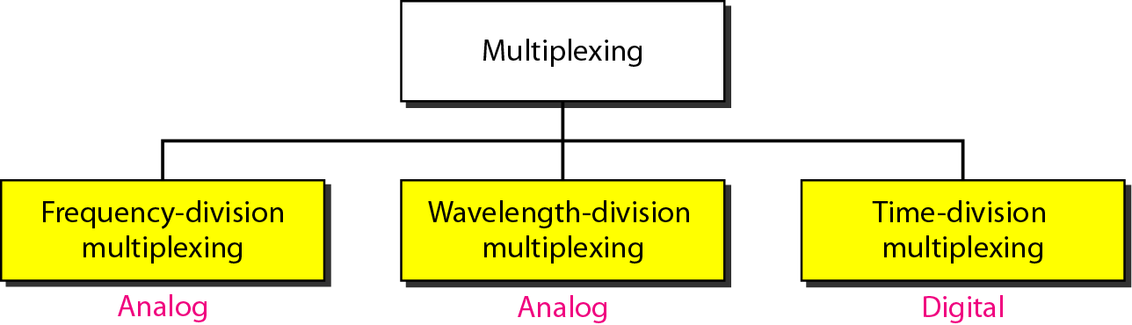
Figure 6.2 Categories of multiplexing
Multiplexing is the set of techniques that allows the (simultaneous) transmission of multiple signals across a single data link. As data and telecommunications use increases, so does traffic.

Slide 82
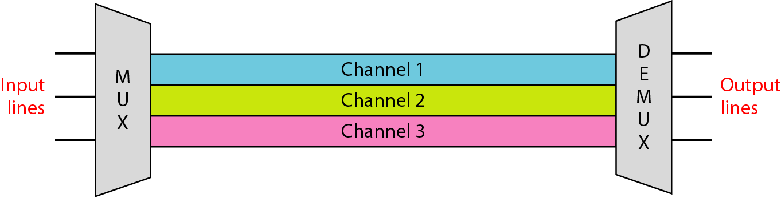
Frequency-division multiplexing (FDM)
FDM is an analog multiplexing technique that combines analog signals.
In FDM, signals generated by each sending device modulate different carrier frequencies.
These modulated signals are then combined into a single composite signal that can be transported by the link.
Carrier frequencies are separated by sufficient bandwidth to accommodate the modulated signal, called guard band.
Figure 6.3 Frequency-division multiplexing (FDM)

Slide 83
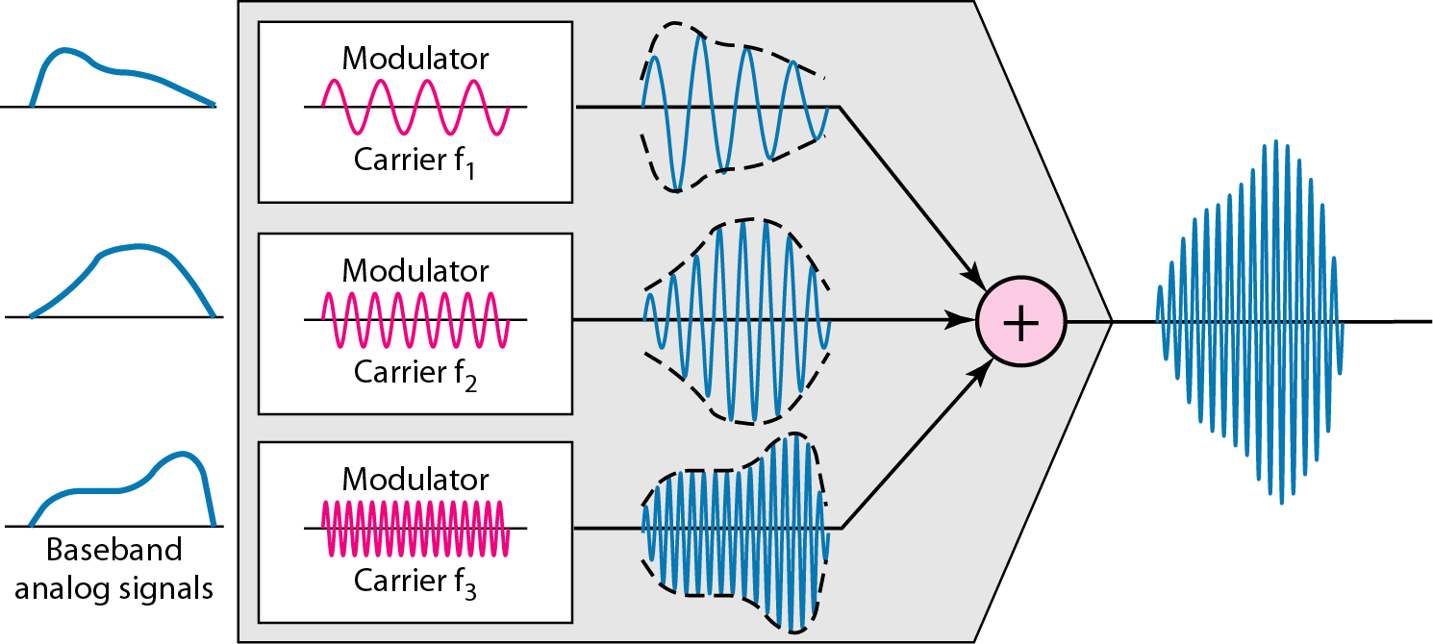
Figure 6.4 FDM process

Slide 84
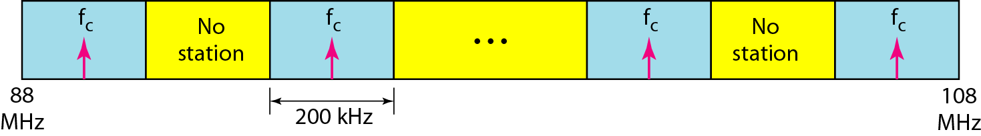
FDM
Channels can be separated by strips of unused bandwidth-guard bands-to prevent signals from overlapping.
In addition, carrier frequencies must not interfere with the original data frequencies.

Slide 85
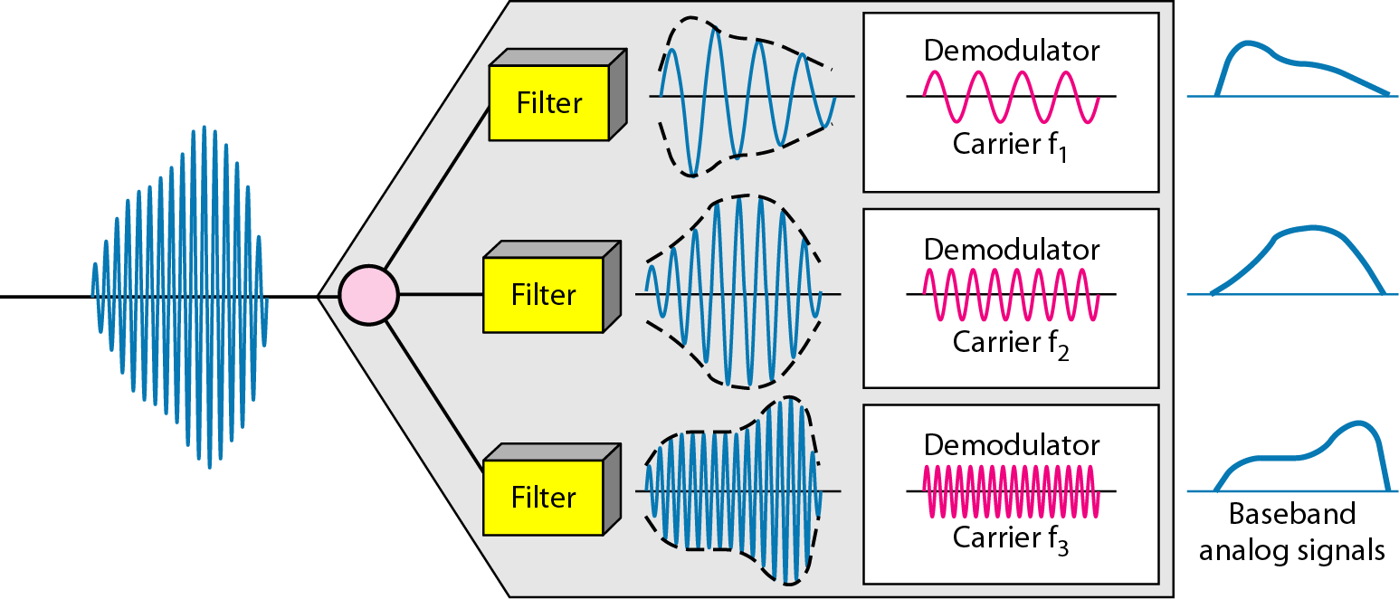
Figure 6.5 FDM demultiplexing example
The demultiplexer uses a series of filters to decompose the multiplexed signal into its constituent component signals.
The individual signals are then passed to a demodulator that separates them from their carriers and passes them to the output lines.

Slide 86
Example 6.1
Assume that a voice channel occupies a bandwidth of 4 kHz. We need to combine three voice channels into a link with a bandwidth of 12 kHz, from 20 to 32 kHz. Show the configuration, using the frequency domain. Assume there are no guard bands.
Solution
We shift (modulate) each of the three voice channels to a different bandwidth, as shown in Figure 6.6. We use the 20- to 24-kHz bandwidth for the first channel, the 24- to 28-kHz bandwidth for the second channel, and the 28- to 32-kHz bandwidth for the third one. Then we combine them as shown in Figure 6.6.

Slide 87
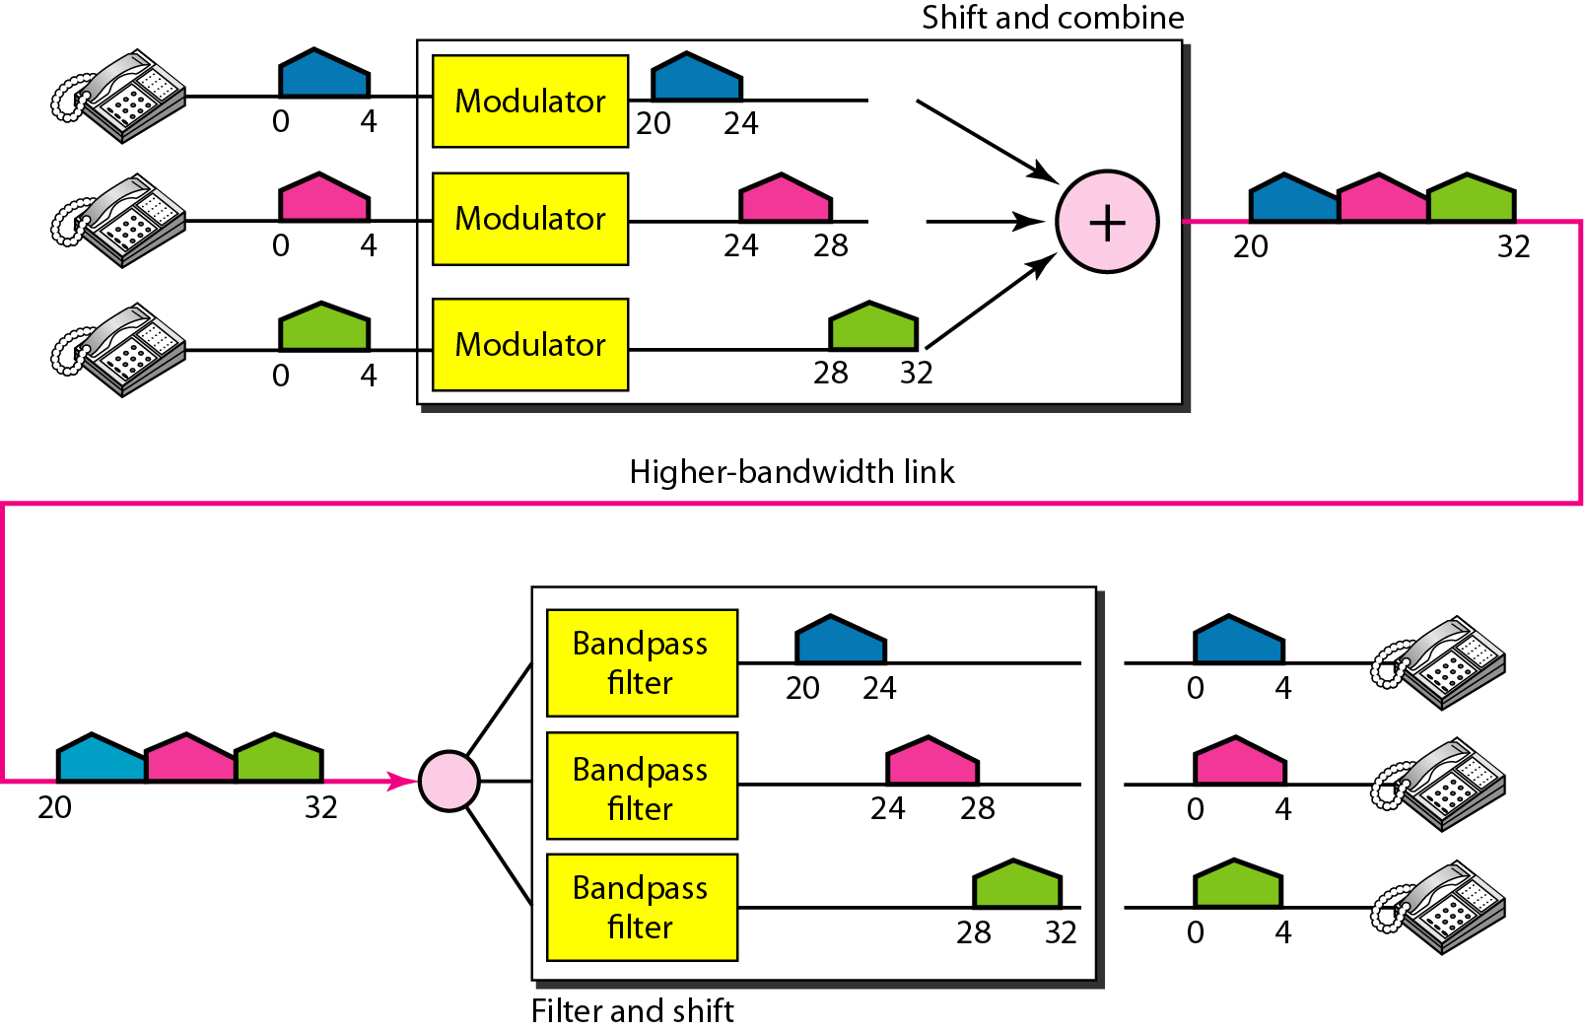
Figure 6.6 Example 6.1

Slide 88
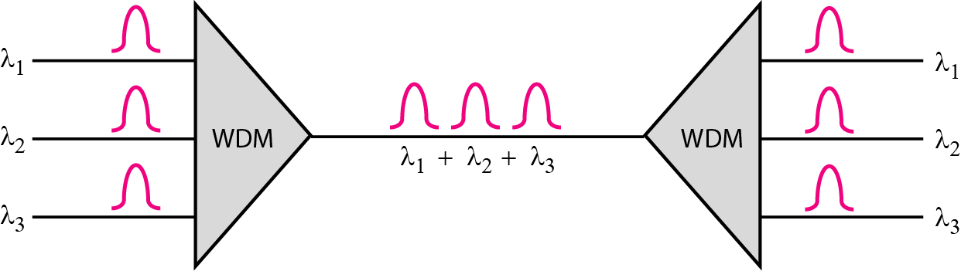
Wavelength-division multiplexing (WDM)
Wavelength-division multiplexing (WDM) is designed to use the high-data-rate capability of fiber-optic cable.
The optical fiber data rate is higher than the data rate of metallic transmission cable.
Using a fiber-optic cable for one single line wastes the available bandwidth.

Slide 89
Note
WDM is an analog multiplexing technique to combine optical signals.

Slide 90
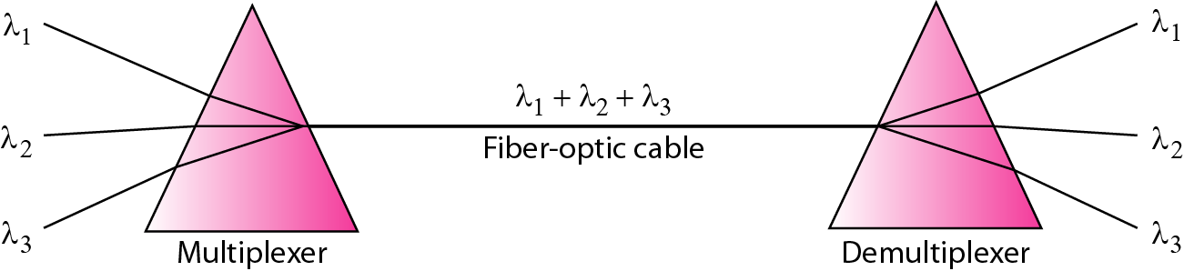
Figure 6.11 Prisms in wavelength-division multiplexing and demultiplexing
We want to combine multiple light sources into one single light at the multiplexer and do the reverse at the demultiplexer.
The combining and splitting of light sources are easily handled by a prism.
Recall from basic physics that a prism bends a beam of light based on the angle of incidence and the frequency.
Using this technique, a multiplexer can be made to combine several input beams of light, each containing a narrow band of frequencies, into one output beam of a wider band of frequencies.

Slide 91

Time Division Multiplexing (TDM)
Time-division multiplexing (TDM) is a digital process that allows several connections to share the high bandwidth of a link.
Instead of sharing a portion of the bandwidth as in FDM, time is shared. Each connection occupies a portion of time in the link.
We can divide TDM into two different schemes: synchronous and statistical.

Slide 92
Note
TDM is a digital multiplexing technique for combining several low-rate digital channels into one high-rate one.

Slide 93

Synchronous time-division multiplexing
In synchronous TDM, the data flow of each input connection is divided into units, where each input occupies one input time slot.
A unit can be 1 bit, one character, or one block of data. Each input unit becomes one output unit and occupies one output time slot.

Slide 94

Interleaving
The process of taking a group of bits from each input line for multiplexing is called interleaving.
We interleave bits (1 - n) from each input onto one output.
Synchronous TDM is not as efficient as it could be. If a source does not have data to send, the corresponding slot in the output frame is empty.

Slide 95

Synchronization
If the multiplexer and the demultiplexer are not synchronized, a bit belonging to one channel may be received by the wrong channel.
For this reason, one or more synchronization bits are usually added to the beginning of each frame.
These bits, called framing bits, follow a pattern, frame to frame, that allows the demultiplexer to synchronize with the incoming stream so that it can separate the time slots accurately.
In most cases, this synchronization information consists of 1 bit per frame, alternating between 0 and 1.

Slide 96
Data Rate Management
Not all input links maybe have the same data rate.
Some links maybe slower. There maybe several different input link speeds.
There are three strategies that can be used to overcome the data rate mismatch: multilevel, multislot and pulse stuffing

Slide 97
Data rate matching
Multilevel: used when the data rate of the input links are multiples of each other.
Multislot: is also used when link’s data rates are multiple of each other. The higher bit rate channels are allocated more slots per frame, and the output frame rate is a multiple of each input link.
Pulse Stuffing: used when there is no direct multiple relation present among different link’s data rate. The slowest speed link will be brought up to the speed of the other links by bit insertion, this is called pulse stuffing.

Slide 98

Figure 6.19 Multilevel multiplexing

Slide 99

Figure 6.20 Multiple-slot multiplexing

Slide 100

Figure 6.21 Pulse stuffing

Slide 101
Statistical Time-Division Multiplexing
Synchronous TDM is inefficient if some input lines have no data to send.
In statistical time-division multiplexing, slots are dynamically allocated to improve bandwidth efficiency.
Only when an input line has a slot's worth of data to send is it given a slot in the output frame.
In statistical multiplexing, the number of slots in each frame is less than the number of input lines. The multiplexer checks each input line in roundrobin fashion; it allocates a slot for an input line if the line has data to send; otherwise, it skips the line and checks the next line

Slide 102

Statistical Time-Division Multiplexing
In statistical multiplexing, the number of slots in each frame is less than the number of input lines. The multiplexer checks each input line in roundrobin fashion; it allocates a slot for an input line if the line has data to send; otherwise, it skips the line and checks the next line

Slide 103

In statistical TDM, a slot needs to carry data as well as the address of the destination.

Slide 104
Transmission media

Slide 105
Transmission Media
A transmission media can be defined as any medium that can carry information from a source to a destination.
Transmission Media
Guided Media (Wired)
Unguided Media (Wireless)
Twisted-Pair Cable
Coaxial Cable
Fiber Optic Cable
Radio Wave
Microwave
Infrared Wave

Slide 106



Guided Media
Guided media are those that provide a wired - channel from one device to another.
It is also referred to as Wired or Bounded transmission media. Signals being transmitted are directed and confined in a narrow pathway by using physical links.
Features: High Speed, Secure
Three Guided media commonly used for data transmission are:
Twisted Pair Cable
Coaxial Cable
Fiber Optic Cable

Slide 107



Twisted Pair Cable
Separately insulated and Twisted together
It is widely used in different kinds of data and voice infrastructure.
The use of two wires twisted together helps to reduce crosstalk and electromagnetic induction. Two types of twisted pair cable:
UTP
(Unshielded Twisted Pair)
STP
(Shielded Twisted Pair)

Slide 108


Twisted Pair Cable – Cont…
UTP(Unshielded Twisted Pair): UTP consists of two insulated copper wires twisted around one another. This type of cable has the ability to block interference and does not depend on a physical shield for this purpose.
Ordinary telephone wires
Less expensive
Weak immunity against noise & interferences
Most used in two categories: Cat-3 & Cat-5
Used in laboratory
STP(Shielded Twisted Pair)
An extra metallic shield on each pair
Relatively more expensive
Eliminates crosstalk
Better performance than UTP
Used in exterior network(outside of building).
The shielded twisted pair type of cable is most frequently used in extremely cold climates

Slide 109

Coaxial Cable
Insulator
Outer conductor is braided shield
Inner conductor is solid metal
Separated by insulating material, and whole cover by plastic cover
Used in television, long distance telephone transmission
High bandwidth and excellent noise immunity
Inner Conductor
Plastic cover
Outer conductor (shield)

Slide 110


Fiber Optic Cable
Glass or plastic core
Laser or light emitting diode
Small size & weight
Used in high bandwidth network
High data rate & lower attenuation
High cost
Fragile

Slide 111
Unguided Media
Unguided media transmit electromagnetic waves without using a physical conductor.
The signal is broadcasted through air, Less Secure, Used for larger distances
This type of communication is often referred to as wireless communication.
Radio wave
Microwave
Infrared Wave

Slide 112


Radio wave
These are easy to generate and can penetrate through buildings.
The sending and receiving antennas need not be aligned. Frequency Range:3KHz – 1GHz.
AM and FM radios and cordless phones use Radio waves for transmission.
Highly regulated
Omni directional antennas
Radio waves are used for multicast communications, such as radio and television, and paging systems
Penetrate through walls

Slide 113


Microwave
It is a line of sight transmission i.e. the sending and receiving antennas need to be properly aligned with each other. The distance covered by the signal is directly proportional to the height of the antenna. Frequency Range:1GHz – 300GHz. These are majorly used for mobile phone communication and television distribution.
Use directional antennas - point to point line of sight communications
Used for unicast communication such as cellular telephones, satellite networks
Higher frequency ranges cannot efficiently penetrate walls

Slide 114

Infrared wave
Infrared signals can be used for short-range communication in a closed area using line-of-sight propagation
Used on televisions, VCRs, and stereos all use infrared communication.
Relatively directional
Cheap, easy to build but they do not pass through solid objects

Slide 115
Thank You

